Slide 1
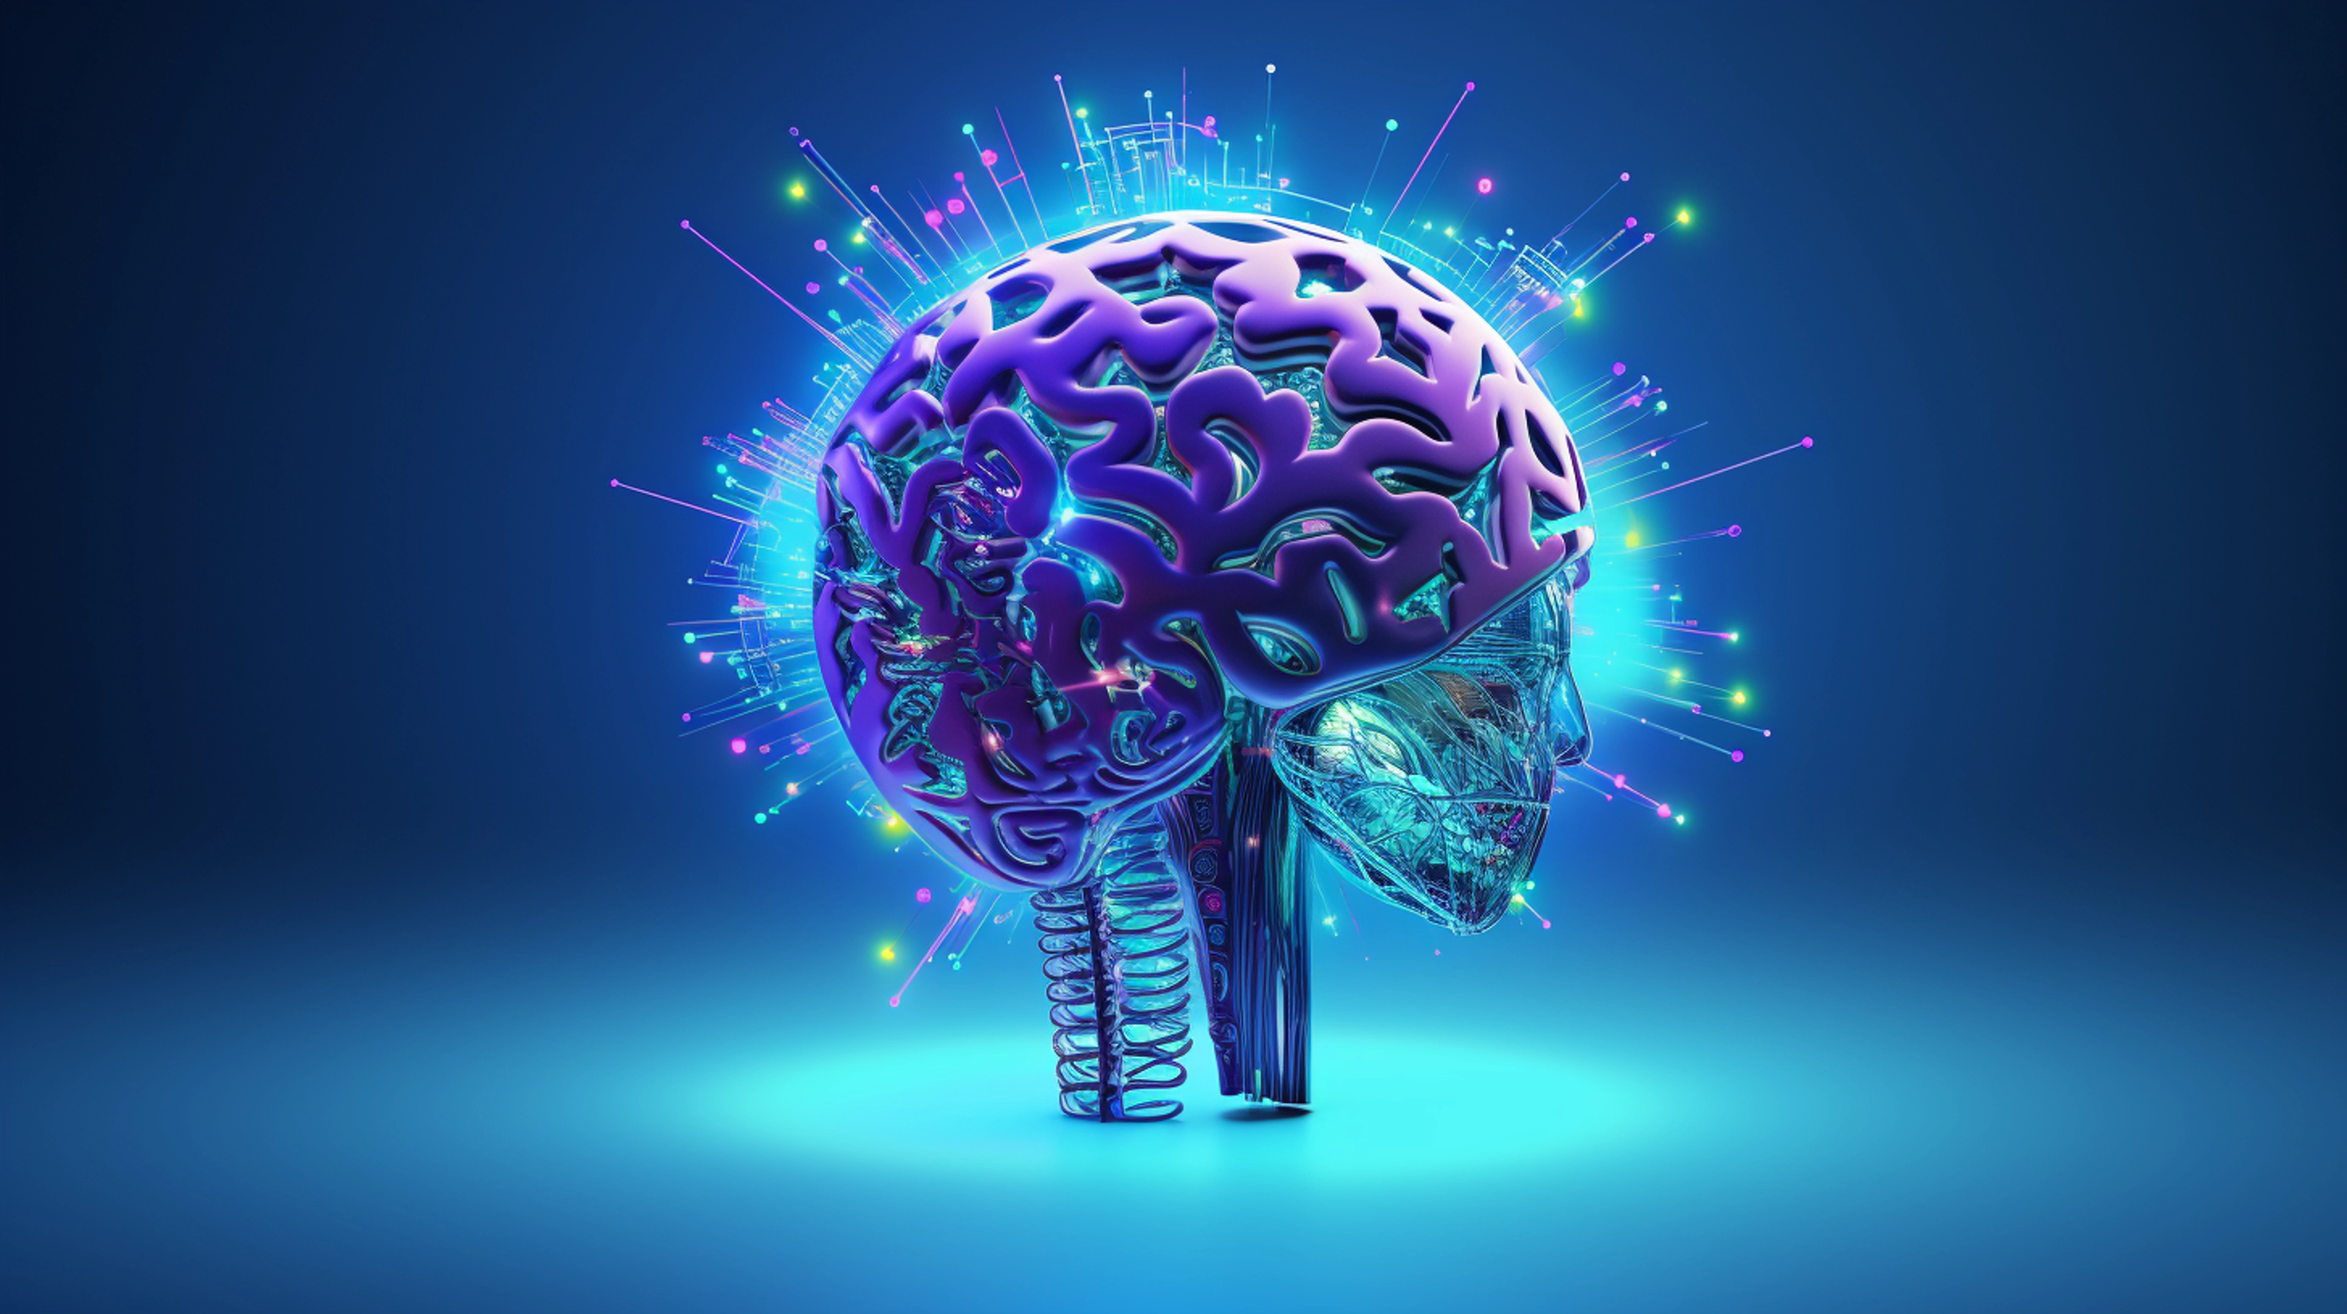
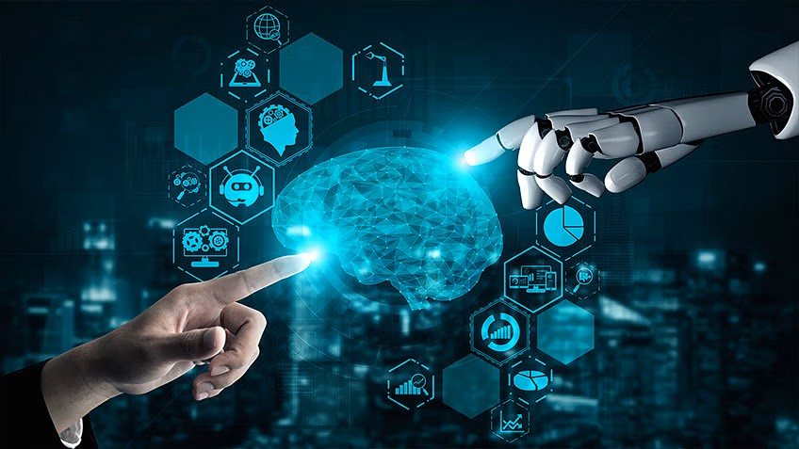
DTI 412
SPACIAL TOPIC
LECTURE 01

Slide 2
DTI 412 SPECIAL TOPIC
Link to powerpoint handout :
https://kbucomsci.weebly.com
QR-Code to handout :

Slide 3
WHAT ‘ S MACHINE LEARNING
Machine Learning (ML) is a subset of artificial intelligence (AI) that focuses on the development of algorithms and statistical models that enable computers to perform specific tasks without explicit instructions. Instead, these systems learn from data, identifying patterns and making decisions based on this analysis.

Slide 4
LEARNING FROM DATA
A general notion of machine learning is to focus on the process of learning from data to discover hidden patterns or predict future events. This data can be anything from customer purchase history and product reviews to sensor readings from machines or images and videos. By analyzing these vast amounts of data, the algorithms identify patterns and relationships, enabling them to make predictions or decisions on new, unseen data.

Slide 5
THE IMPORTANCE OF MACHINE LEARNING
The importance of machine learning (ML) can be understood from various perspectives: its impact on industries, the capabilities it offers, and the career opportunities it unlocks. Here's a breakdown of its significance:
Impact on Industries:
Automating Tasks and Processes: Machine learning algorithms can automate repetitive and time-consuming tasks, improving efficiency and productivity across various sectors. From manufacturing robots to chatbots in customer service, ML is streamlining workflows.

Slide 6
THE IMPORTANCE OF MACHINE LEARNING
Data-Driven Decision Making: ML empowers businesses to leverage data for informed decision-making. By analyzing vast amounts of data, companies can gain insights into customer behavior, market trends, and potential risks, enabling them to make strategic choices.
Innovation and Progress: Machine learning is driving innovation in numerous fields. From medical diagnosis and drug discovery in healthcare to developing self-driving cars and financial fraud detection, ML is pushing the boundaries of what's possible.
Data-Driven Decision Making: ML empowers businesses to leverage data for informed decision-making. By analyzing vast amounts of data, companies can gain insights into customer behavior, market trends, and potential risks, enabling them to make strategic choices.
Innovation and Progress: Machine learning is driving innovation in numerous fields. From medical diagnosis and drug discovery in healthcare to developing self-driving cars and financial fraud detection, ML is pushing the boundaries of what's possible.
Impact on Industries:
Data-Driven Decision Making: ML empowers businesses to leverage data for informed decision-making. By analyzing vast amounts of data, companies can gain insights into customer behavior, market trends, and potential risks, enabling them to make strategic choices.
Innovation and Progress: Machine learning is driving innovation in numerous fields. From medical diagnosis and drug discovery in healthcare to developing self-driving cars and financial fraud detection, ML is pushing the boundaries of what's possible.

Slide 7
THE IMPORTANCE OF MACHINE LEARNING
Data-Driven Decision Making: ML empowers businesses to leverage data for informed decision-making. By analyzing vast amounts of data, companies can gain insights into customer behavior, market trends, and potential risks, enabling them to make strategic choices.
Innovation and Progress: Machine learning is driving innovation in numerous fields. From medical diagnosis and drug discovery in healthcare to developing self-driving cars and financial fraud detection, ML is pushing the boundaries of what's possible.
Data-Driven Decision Making: ML empowers businesses to leverage data for informed decision-making. By analyzing vast amounts of data, companies can gain insights into customer behavior, market trends, and potential risks, enabling them to make strategic choices.
Innovation and Progress: Machine learning is driving innovation in numerous fields. From medical diagnosis and drug discovery in healthcare to developing self-driving cars and financial fraud detection, ML is pushing the boundaries of what's possible.
Capabilities of Machine Learning:
Pattern Recognition and Prediction: Machine learning algorithms excel at identifying patterns and relationships within data. This allows them to make predictions about future events, recommend relevant products or content to users, and personalize experiences.
Continuous Learning and Improvement: Unlike traditional software, machine learning models can continuously learn and improve over time. As they are exposed to more data, they can refine their predictions and become more accurate.

Slide 8
THE IMPORTANCE OF MACHINE LEARNING
Data-Driven Decision Making: ML empowers businesses to leverage data for informed decision-making. By analyzing vast amounts of data, companies can gain insights into customer behavior, market trends, and potential risks, enabling them to make strategic choices.
Innovation and Progress: Machine learning is driving innovation in numerous fields. From medical diagnosis and drug discovery in healthcare to developing self-driving cars and financial fraud detection, ML is pushing the boundaries of what's possible.
Data-Driven Decision Making: ML empowers businesses to leverage data for informed decision-making. By analyzing vast amounts of data, companies can gain insights into customer behavior, market trends, and potential risks, enabling them to make strategic choices.
Innovation and Progress: Machine learning is driving innovation in numerous fields. From medical diagnosis and drug discovery in healthcare to developing self-driving cars and financial fraud detection, ML is pushing the boundaries of what's possible.
Capabilities of Machine Learning:
Handling Complex Data: Machine learning algorithms can handle large and complex datasets that would be overwhelming for traditional data analysis methods. This allows them to uncover hidden patterns and insights that might go unnoticed with simpler approaches.

Slide 9
THE IMPORTANCE OF MACHINE LEARNING
Data-Driven Decision Making: ML empowers businesses to leverage data for informed decision-making. By analyzing vast amounts of data, companies can gain insights into customer behavior, market trends, and potential risks, enabling them to make strategic choices.
Innovation and Progress: Machine learning is driving innovation in numerous fields. From medical diagnosis and drug discovery in healthcare to developing self-driving cars and financial fraud detection, ML is pushing the boundaries of what's possible.
Data-Driven Decision Making: ML empowers businesses to leverage data for informed decision-making. By analyzing vast amounts of data, companies can gain insights into customer behavior, market trends, and potential risks, enabling them to make strategic choices.
Innovation and Progress: Machine learning is driving innovation in numerous fields. From medical diagnosis and drug discovery in healthcare to developing self-driving cars and financial fraud detection, ML is pushing the boundaries of what's possible.
Capabilities of Machine Learning:
Handling Complex Data: Machine learning algorithms can handle large and complex datasets that would be overwhelming for traditional data analysis methods. This allows them to uncover hidden patterns and insights that might go unnoticed with simpler approaches.

Slide 10
TYPE OF MACHINE LEARNING
Machine Learning can be broadly categorized into three main types:
Supervised Learning
Unsupervised Learning
Reinforcement Learning
Each type has distinct methodologies and applications, depending on the nature of the data and the problem to be solved.

Slide 11
SUPERVISED LEARNING
Supervised Learning: Involves training the model with labeled data, where each data point has a corresponding label or target value. The model learns the mapping between the features (inputs) and the labels (outputs) and can then predict labels for new, unseen data. (e.g., classifying emails as spam or not spam based on past examples)

Slide 12
UNSUPERVISED LEARNING
Unsupervised Learning: Deals with unlabeled data, where the model seeks to uncover hidden patterns or groupings within the data itself. This can involve tasks like customer segmentation (grouping customers based on similar characteristics) or anomaly detection (identifying unusual patterns in data).

Slide 13
REINFORCEMENT LEARNING
Reinforcement Learning: Involves training a model through trial and error in a simulated environment. The model receives rewards for good actions and penalties for bad actions, allowing it to learn optimal behavior over time. This is useful for training AI agents to play games or control robots.

Slide 14
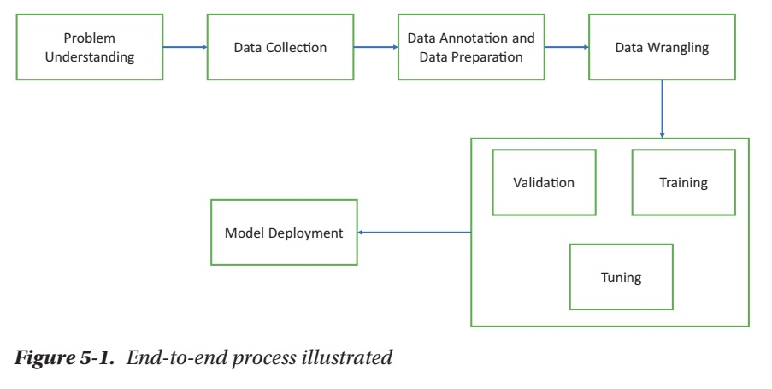
END TO END PROCESS OF ML

Slide 15
END TO END PROCESS OF ML
Problem Understanding: Setting the Stage for Success
What is the problem you're trying to solve? Clearly define the task you want your model to perform. Is it predicting housing prices, classifying customer churn, or recognizing objects in images?

Slide 16
END TO END PROCESS OF ML
Problem Understanding: Setting the Stage for Success
What are your success metrics? Determine how you'll measure the model's performance. This could be accuracy for classification tasks, mean squared error for regression tasks, or other relevant metrics specific to your problem.
What kind of data do you need? Consider the data required to train and evaluate your model.

Slide 17
END TO END PROCESS OF ML
Data Collection: Gathering the Raw Materials
Identify data sources: Locate relevant data sources that align with your problem definition. This could involve internal databases, public datasets, web scraping, or APIs (Application Programming Interfaces).

Slide 18
END TO END PROCESS OF ML
Data Collection: Gathering the Raw Materials
Collect and store the data: Gather the data from the identified sources and store it in a secure and accessible format. This might involve data warehousing or cloud storage solutions.
Ensure data quality: Assess the quality of the collected data. Look for missing values, inconsistencies, errors, and outliers that might need cleaning or pre-processing.

Slide 19
END TO END PROCESS OF ML
Data Annotation and Preparation:
Shaping the Data for Learning
Data cleaning: Address missing values, inconsistencies, and errors in the data. Techniques like imputation (filling in missing entries) or outlier removal might be necessary.

Slide 20
END TO END PROCESS OF ML
Data Annotation and Preparation:
Shaping the Data for Learning
Data labeling (if applicable): For supervised learning tasks, some data might require labeling. This involves assigning categories or target values to each data point.
Data formatting: Transform the data into a format suitable for the chosen machine learning algorithm. This may involve scaling numerical features, encoding categorical features, or handling text data appropriately.

Slide 21
END TO END PROCESS OF ML
Data Wrangling: Transforming the Raw Material
Feature engineering: This crucial step involves creating new features from existing ones or transforming features to enhance the model's learning ability. Domain knowledge is often essential for effective feature engineering.

Slide 22
END TO END PROCESS OF ML
Data Wrangling: Transforming the Raw Material
Data integration: If your project involves data from multiple sources, data integration ensures consistent formatting and combines the data into a cohesive dataset for analysis.
Dimensionality reduction (if applicable): In high-dimensional settings, dimensionality reduction techniques can be used to reduce the number of features without losing significant information.

Slide 23
END TO END PROCESS OF ML
Model Training: Building the Machine
Model selection: Choose a machine learning algorithm suitable for your problem type (classification, regression, etc.) and data characteristics. Consider factors like interpretability, computational efficiency, and desired performance.

Slide 24
END TO END PROCESS OF ML
Model Training: Building the Machine
Model training: Split your data into training and testing sets. The training set is used to train the model, and the testing set is used to evaluate its performance on unseen data.
Training the model: The model learns from the training data, building internal parameters that map the input features to the desired output (predictions). This process involves optimization algorithms that adjust the model's parameters to minimize errors on the training data.

Slide 25
END TO END PROCESS OF ML
Model Validation: Evaluating the Learner
Testing the model: Apply the trained model to the testing data and evaluate its performance using the pre-defined success metrics. This helps assess how well the model generalizes to unseen data and avoids overfitting to the training data.

Slide 26
END TO END PROCESS OF ML
Model Validation: Evaluating the Learner
Error analysis: Analyze the errors made by the model on the testing data. This can help identify weaknesses and areas for improvement.
Model selection or tuning: Based on the validation results, you might decide to select a different model or fine-tune the hyperparameters (internal settings) of the chosen model to improve its performance.

Slide 27
END TO END PROCESS OF ML
Model Deployment: Putting the Model to Work (Optional)
Model deployment: Once a satisfactory model is obtained, it can be deployed into production. This involves integrating the model into an application or system where it can be used to make real-time predictions on new data.

Slide 28
END TO END PROCESS OF ML
Model Deployment: Putting the Model to Work (Optional)
Monitoring and maintenance: Continuously monitor the performance of the deployed model in production. Over time, the data distribution or underlying relationships might change, requiring retraining or adjustments to the model.

Slide 29
INTRODUCTION TO PYTHON
Keywords
In Python, a keyword is a word that has a special meaning in the Python language. Keywords are used to define the syntax and structure of the Python language, and they cannot be used as identifiers (i.e., variable names, function names, etc.) in Python code.

Slide 30
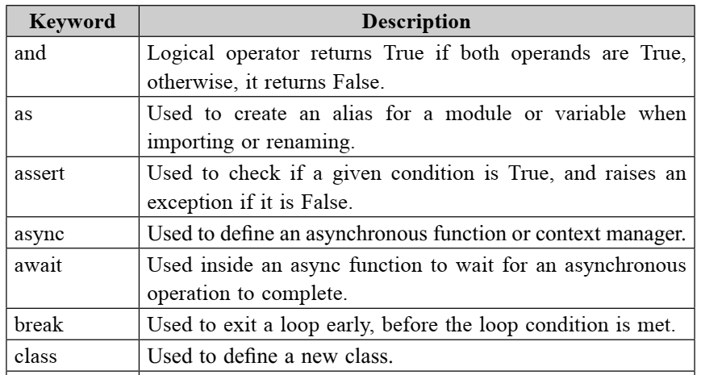
INTRODUCTION TO PYTHON

Slide 31
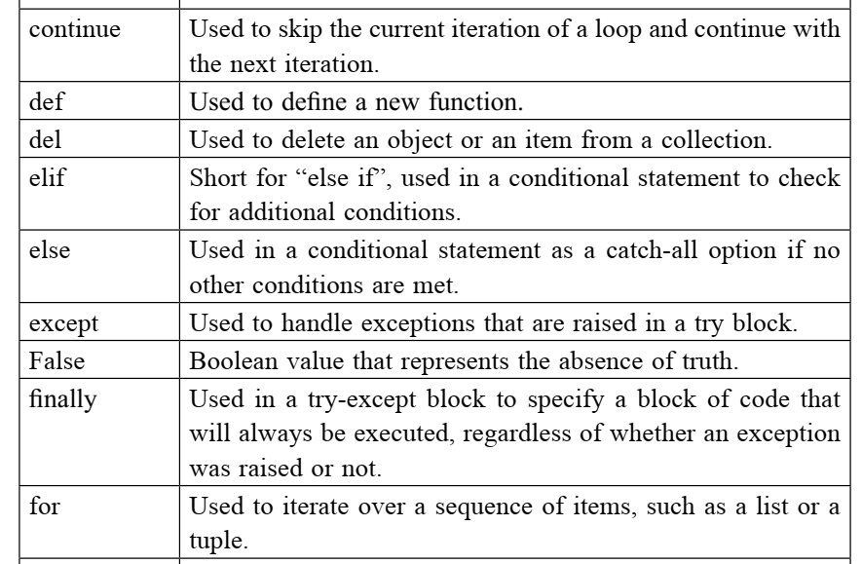
INTRODUCTION TO PYTHON

Slide 32
INTRODUCTION TO PYTHON
Identifiers
In Python, an identifier is a name used to identify a variable, function, class, module, or other objects. There are a few rules and conventions for naming identifiers in Python:
• Identifiers must start with a letter or an underscore (_).
• Identifiers cannot start with a number.

Slide 33
INTRODUCTION TO PYTHON
Identifiers
• Identifiers can only contain letters, numbers, and underscores.
• Identifiers are case-sensitive, so myVariable and myvariable are considered to be different identifiers.

Slide 34
INTRODUCTION TO PYTHON
Identifiers
Python reserves a set of keywords that cannot be used as identifiers.
Examples include if, else, for, class, etc.
Identifiers should be descriptive and meaningful, using camelCase or snake_case, depending on the project’s style guide.

Slide 35
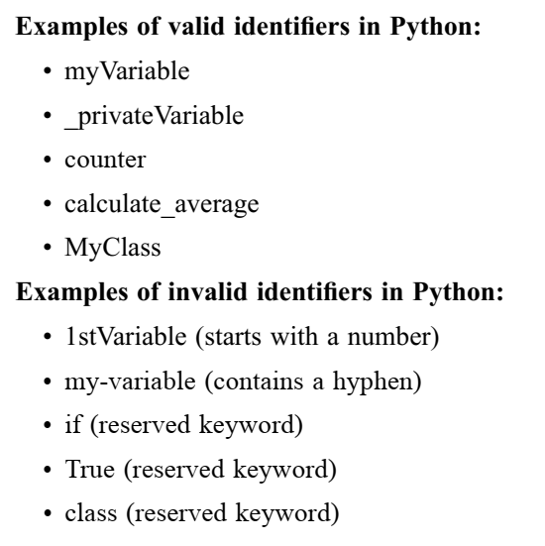
INTRODUCTION TO PYTHON

Slide 36
INTRODUCTION TO PYTHON
Python Statements
In Python, a statement is a single line of code that performs a specific action or instruction. There are several types of statements in Python, including:
• Expressions: These are statements that evaluate to a value, such as mathematical operations or function calls. Examples include “2 + 2” or
“print(‘Hello, world!’)”.
•

Slide 37
INTRODUCTION TO PYTHON
Python Statements
• Assignment statements: These are statements that assign a value to a variable. Examples include “x = 2” or “name = ‘John’”.
• Control flow statements: These are statements that control the flow of execution of a program, such as conditional statements (if/else) and loops (for/while).

Slide 38
INTRODUCTION TO PYTHON
Python Statements
• Function and class definitions: These are statements that define a function or class, respectively. Examples include “def my_function():” and “class MyClass:”.
• Import statements: These statements are used to import modules or packages in python. Examples include “import os” or “from math import sqrt”

