Slide 1
Data Structure and Algorithm
DTI 212
Lecture 02

Slide 2

DTI 212 Data Structure and Algorithm
Link to powerpoint handout :
https://kbucomsci.weebly.com
QR-Code to handout :

Slide 3
Priority Queues

Slide 4
Priority Queue implementation

Slide 5
Priority Queues:
A Model using Multiple Queues

Slide 6
Linked-list

Slide 7
Linkedlist:
Consequences

Slide 8
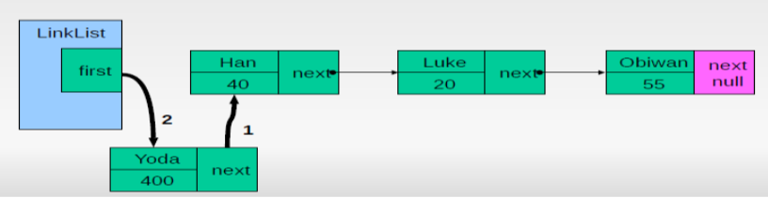
Linkedlist: insertFirst method

Slide 9
Linkedlist: deleteFirst method

Slide 10
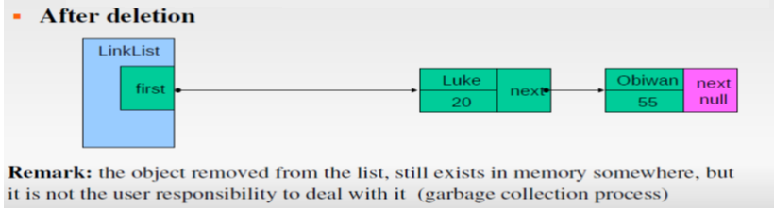
Linkedlist: deleteFirst method

Slide 11
LinkedList:
Delete a specific link

Slide 12
Doubly Linked List

Slide 13
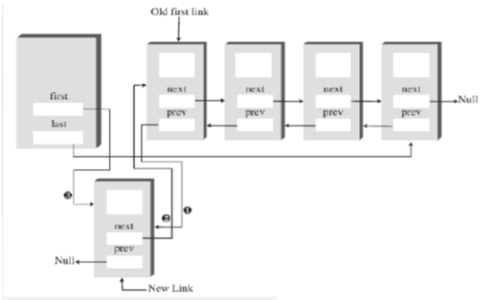
Doubly Linked-List: insertFirst

Slide 14
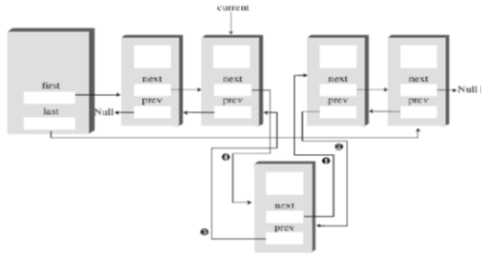
Doubly Linked-List: insertAfter

Slide 15
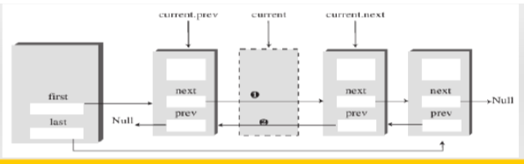
Doubly Linked-List: delete

Slide 16
Recursion

Slide 17
Example 1: Triangular numbers/ summation

Slide 18
Example 1: Triangular numbers/ summation

Slide 19
Example 1: Triangular numbers/ summation

Slide 20
Example 1: Triangular numbers/ summation

Slide 21
Example 2: Factorial

Slide 22
Example 3: Fibonacci numbers

Slide 23
TREE
The tree is a nonlinear hierarchical data structure and comprises a collection of entities known as nodes. It connects each node in the tree data structure using "edges”, both directed and undirected.

Slide 24
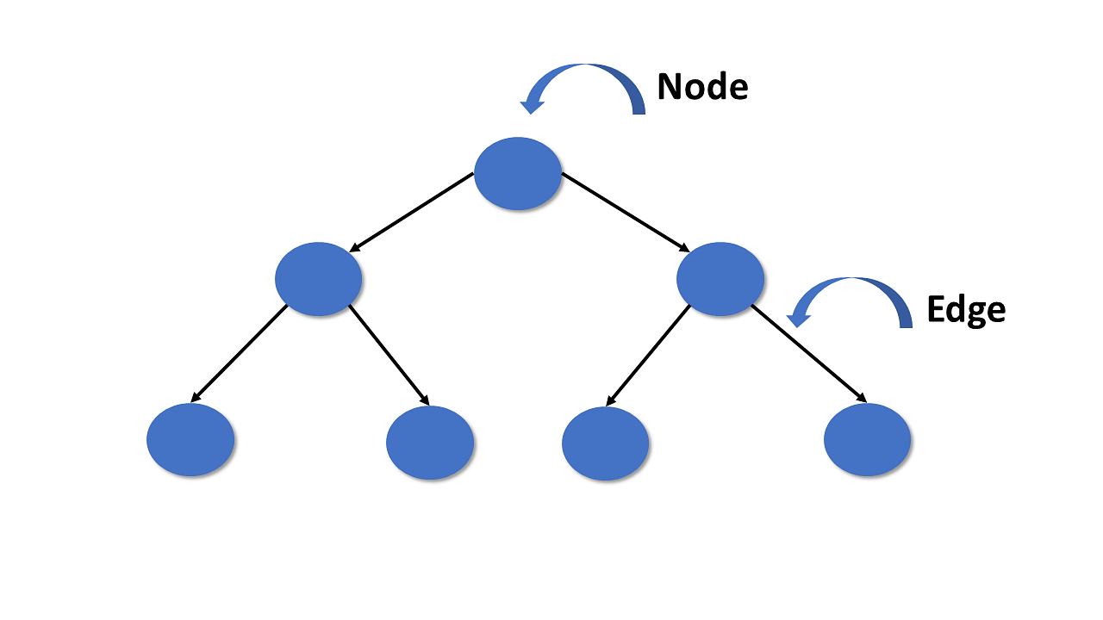
TREE
The image below represents the tree data structure. The blue-colored circles depict the nodes of the tree and the black lines connecting each node with another are called edges.

Slide 25
TREE
Trees have
two main characteristics:
• Each item can have multiple children.
• All items, except a privileged item called the root, have exactly one parent. The root has
no parent.

Slide 26
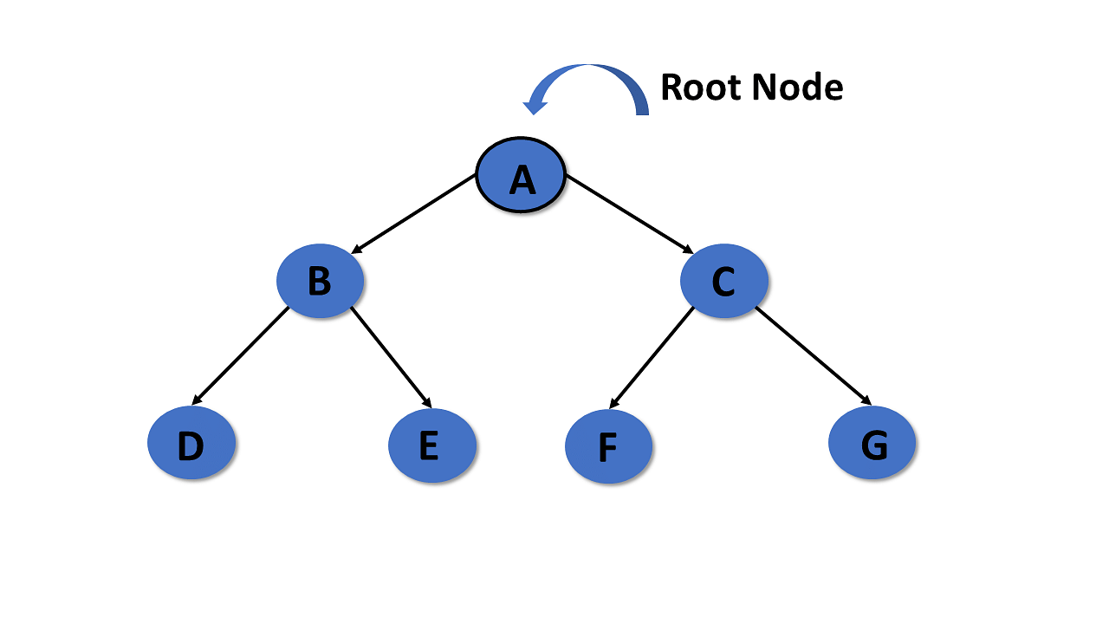
TREE

Slide 27
TREE
Parent
In the tree in data structures, the node that is the predecessor of any node is known as a parent node, or a node with a branch from itself to any other successive node is called the parent node.

Slide 28
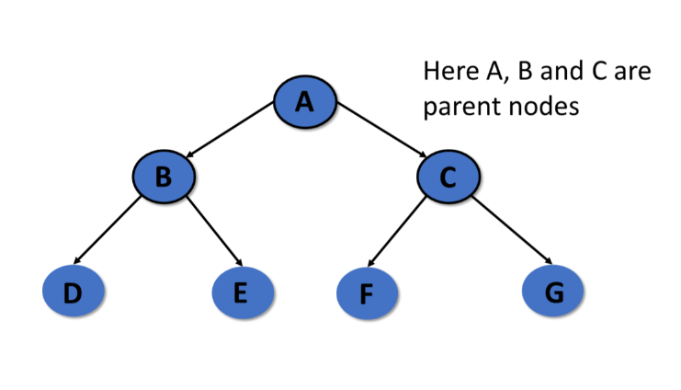
TREE
Parent

Slide 29
TREE
Child
The node, a descendant of any node, is known as child nodes in data structures.
In a tree, any number of parent nodes can have any number of child nodes.
In a tree, every node except the root node is a child node.

Slide 30
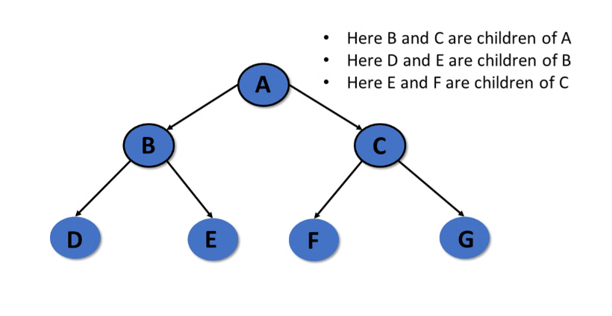
TREE
Child

Slide 31
TREE
The table shows a tree and some of its properties.

Slide 32
TREE
The table shows a tree and some of its properties.

Slide 33
TREE
A Summary of Terms Used to Describe Trees

Slide 34
BINARY TREE
In a binary tree, each node has at most two children,
referred to as the left child and the right child. In a binary tree, when a node has only one child, you distinguish it as being either a left child or a right child. Thus, the two trees shown in Figure 10-2 are not the same when they are considered binary trees, although they are the same when they are considered general trees.

Slide 35
BINARY TREE
Figure 10-2 :

Slide 36
BINARY TREE

Slide 37
POSSIBLE SLOTS FOR NODES IN A BINARY TREE

Slide 38
TYPE OF BINARY TREE
Complete Binary Trees:
A complete binary tree is a type of binary
tree which obeys/satisfies two properties:
(a) First, every level in a complete binary tree except the last one must be completely filled.
(b) Second, all the nodes in the complete binary tree must appear left as much as possible.

Slide 39
TYPE OF BINARY TREE
Complete Binary Trees:

Slide 40
TYPE OF BINARY TREE
Extended Binary Trees:
Extended binary trees are also known as 2T-trees. A binary tree is said to be an extended binary tree if and only if every node in the tree has either zero children or two children. In an extended binary tree, nodes having two children are known as internal nodes. On the contrary, nodes having no children are known as external nodes.

Slide 41
TYPE OF BINARY TREE
Extended Binary Trees:
the internal nodes are represented by I and the external nodes are represented by E.

Slide 42
TYPE OF BINARY TREE
Full binary tree:
A full binary tree is a binary tree in which each interior node contains two children.

Slide 43
TYPE OF BINARY TREE
Perfect binary tree:
A perfect binary tree is a full binary tree in which all leaf nodes are at the same level. The perfect tree has all possible node slots filled from top to bottom with no gaps, as illustrated in Figure 13.8.

Slide 44
TREE TRAVERSALS
Preorder Traversal:
A tree traversal must begin with the root node, since that is the only access into the tree. After visiting the root node, we can then traverse the nodes in its left subtree followed by the nodes in its right subtree.

Slide 45
PREORDER TRAVERSAL
The traversal: A, B, D, E, H, C, F, G,I, J.

Slide 46
TREE TRAVERSALS
Inorder Traversal:
Another traversal that can be performed is the inorder traversal, in which we first traverse the left subtree and then visit the node followed by the traversal of the right subtree.

Slide 47
INORDER TRAVERSAL
The traversal: D, B, H, E, A, F, C, I, G, J.

Slide 48
TREE TRAVERSALS
Postorder Traversal:
We can also perform a postorder traversal, which can be viewed as the opposite of the preorder traversal. In a postorder traversal, the left and right subtrees of each node are traversed before the node is visited.

Slide 49
POSTORDER TRAVERSAL
The traversal: D, H, E, B, F, I, J, G, C, A.

Slide 50
TREE TRAVERSALS
Breadth-First Traversal:
The preorder, inorder, and postorder traversals are all examples of a depth-first traversal. That is, the nodes are traversed deeper in the tree before returning to higher-level nodes. Another type of traversal that can be performed on a binary tree is the breadth-first traversal. In a breadth-first traversal, the nodes are visited by level, from left to right.

Slide 51
BREADTH-FIRST TRAVERSAL
The traversal: A, B, C, D, E, F, G, H, I, J.

Slide 52
EXPRESSION TREES
Arithmetic expressions such as (9+3)*(8-4) can be represented using an expression tree. An expression tree is a binary tree in which the operators are stored in the interior nodes and the operands (the variables or constant values) are stored in the leaves.

Slide 53
EXPRESSION TREES
Arithmetic expressions use inorder traversal

Slide 54
EXPRESSION TREES
Arithmetic expressions use inorder traversal
3+1*3/9-5+2-3*7-4+6

Slide 55


