Slide 1
COMPUTER ARCITECTURE
DTI 112
AND OPERATING SYSTEM
LECTURE 07

Slide 2
Computer Architecture
Link to powerpoint handout :
https://kbucomsci.weebly.com
QR-Code to handout :

Slide 3
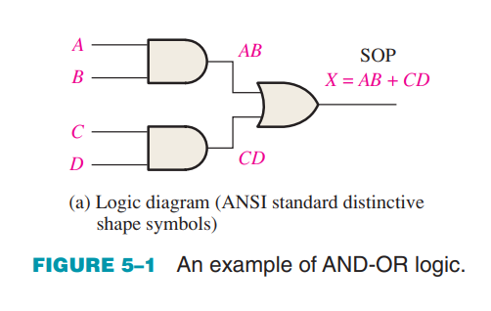
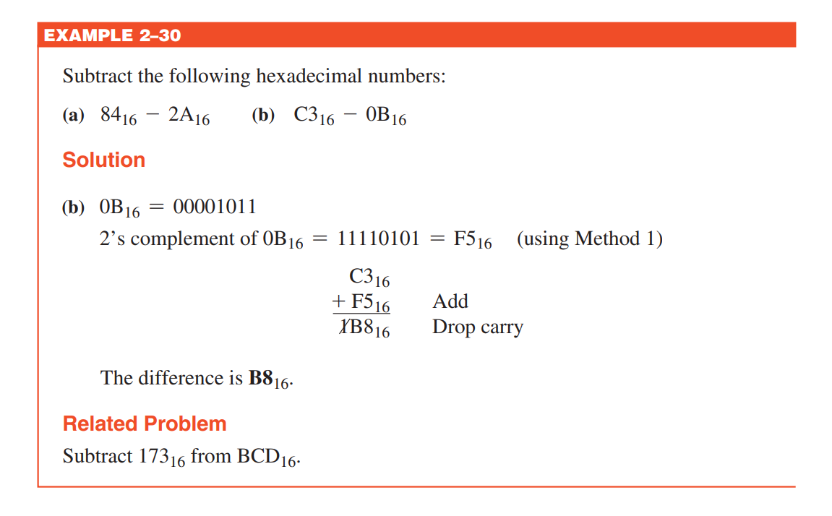
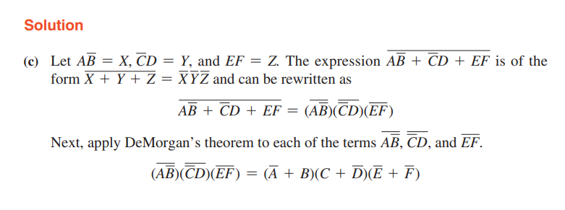
BASIC COMBINATIONAL LOGIC CIRCUITS
AND-OR Logic
Figure 5–1 shows an AND-OR circuit consisting of two 2-input AND gates and one 2-input OR gate

Slide 4
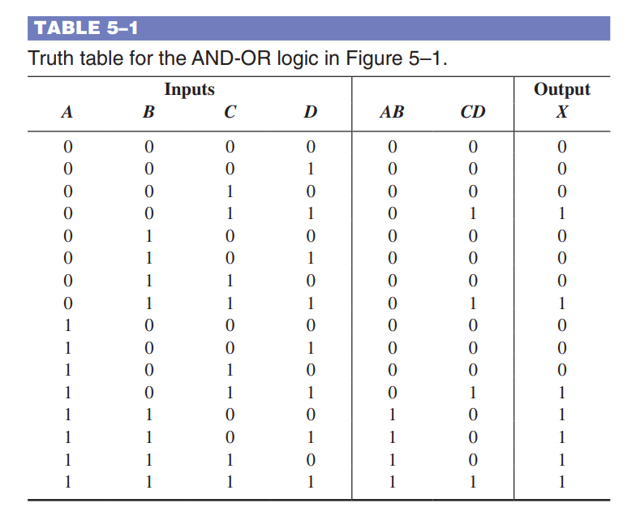
BASIC COMBINATIONAL LOGIC CIRCUITS
AND-OR Logic
The truth table for a 4-input
AND-OR logic circuit is shown
in Table 5–1. The intermediate
AND gate outputs
(the AB and CD columns)
are also shown in the table.

Slide 5
BASIC COMBINATIONAL LOGIC CIRCUITS

Slide 6
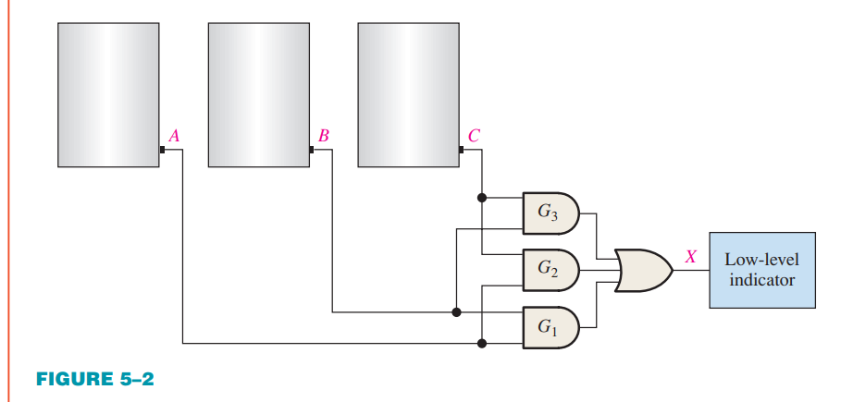
BASIC COMBINATIONAL LOGIC CIRCUITS

Slide 7
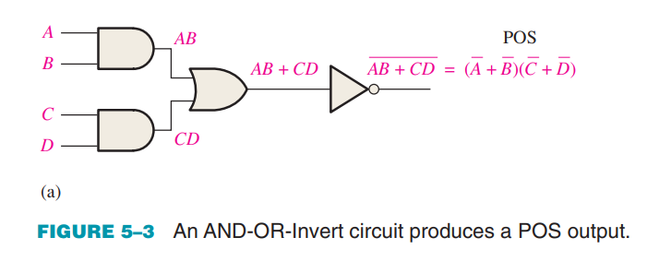
BASIC COMBINATIONAL LOGIC CIRCUITS
AND-OR-Invert Logic
When the output of an AND-OR circuit is complemented (inverted), it results in an AND-ORInvert circuit. The logic diagram in Figure 5–3(a) shows an AND-OR-Invert circuit with four inputs and the development of the POS output expression.

Slide 8
BASIC COMBINATIONAL LOGIC CIRCUITS

Slide 9
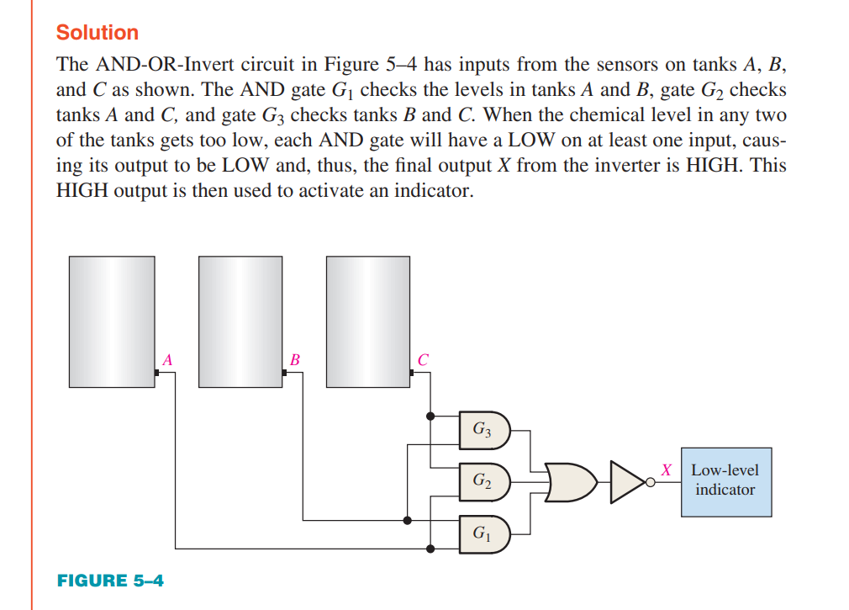
BASIC COMBINATIONAL LOGIC CIRCUITS

Slide 10
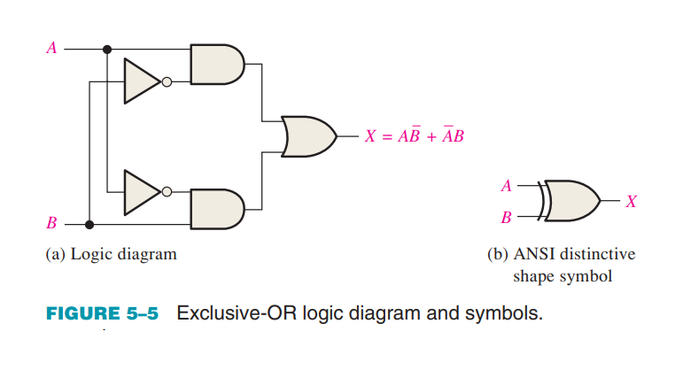
BASIC COMBINATIONAL LOGIC CIRCUITS
Exclusive-OR Logic
it is actually a combination of two AND gates, one OR gate, and two inverters, as shown in Figure 5–5(a).

Slide 11
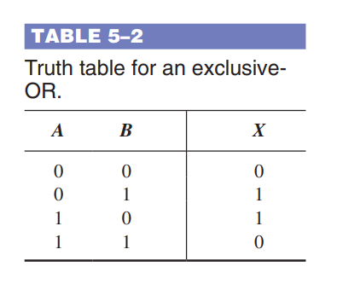
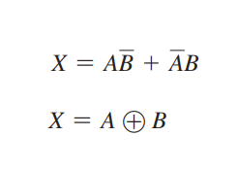
BASIC COMBINATIONAL LOGIC CIRCUITS
Truth table for an exclusiveOR.

Slide 12
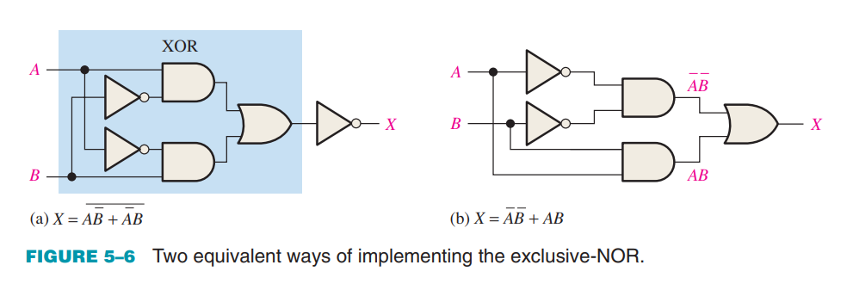
BASIC COMBINATIONAL LOGIC CIRCUITS
Exclusive-NOR Logic
As you know, the complement of the exclusive-OR function is the exclusive-NOR, which is derived as follows:

Slide 13
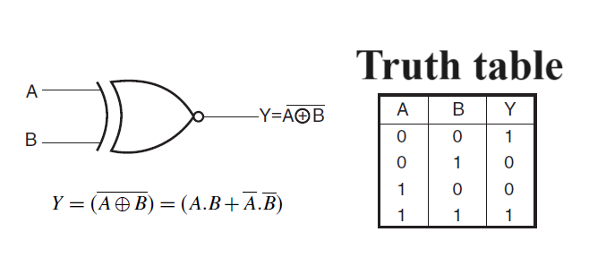
BASIC COMBINATIONAL LOGIC CIRCUITS
Exclusive-NOR Logic

Slide 14
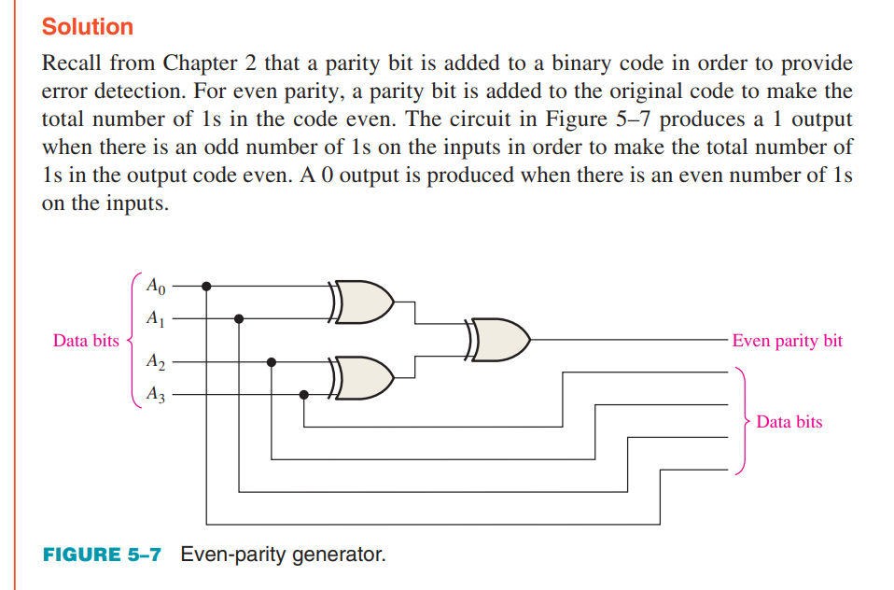
BASIC COMBINATIONAL LOGIC CIRCUITS

Slide 15
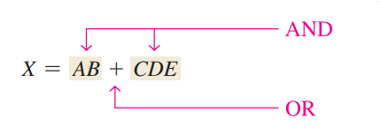
IMPLEMENT COMBINATIONAL LOGIC
Let’s examine the following Boolean expression: X = AB + CDE
A brief inspection shows that this expression is composed of two terms, AB and CDE, with a domain of five variables. The first term is formed by ANDing A with B, and the second term is formed by ANDing C, D, and E. The two terms are then ORed to form the output X. These operations are indicated in the structure of the expression as follows:

Slide 16
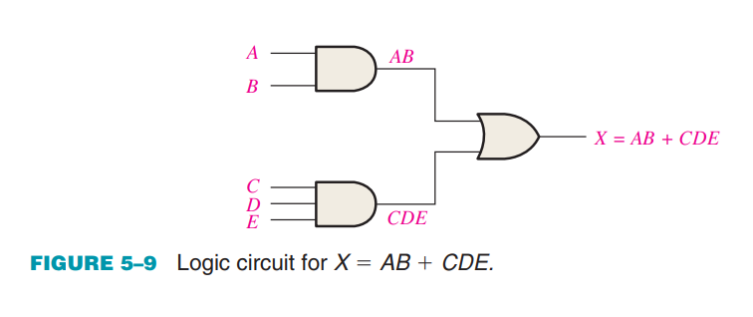
IMPLEMENT COMBINATIONAL LOGIC
To implement this Boolean expression, a 2-input AND gate is required to form the term AB, and a 3-input AND gate is needed to form the term CDE. A 2-input OR gate is then required to combine the two AND terms. The resulting logic circuit is shown in Figure 5–9.

Slide 17
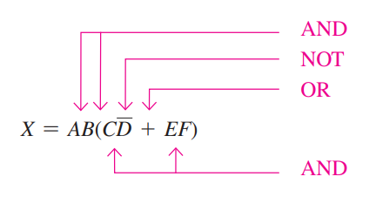
IMPLEMENT COMBINATIONAL LOGIC
As another example, let’s implement the following expression:
A breakdown of this expression shows that the terms AB and (CD + EF) are ANDed. The term CD + EF is formed by first ANDing C and D and ANDing E and F, and then ORing these two terms. This structure is indicated in relation to the expression as follows:

Slide 18
IMPLEMENT COMBINATIONAL LOGIC
The logic gates required to implement are as follows:

Slide 19
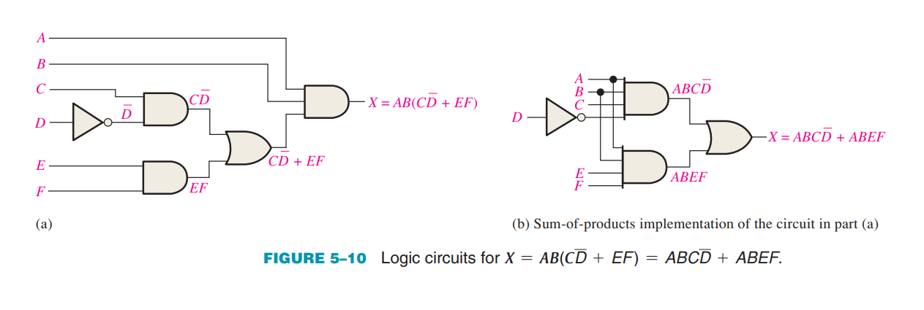
IMPLEMENT COMBINATIONAL LOGIC
:

Slide 20
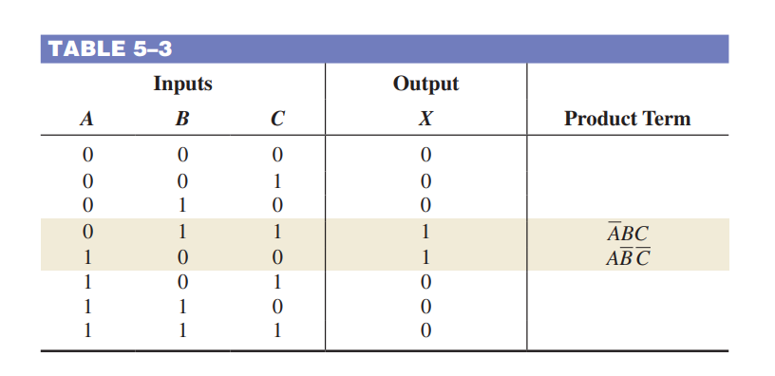
IMPLEMENT COMBINATIONAL LOGIC
From a Truth Table to a Logic Circuit
If you begin with a truth table instead of an expression, you can write the SOP expression from the truth table and then implement the logic circuit. Table 5–3 specifies a logic function.

Slide 21
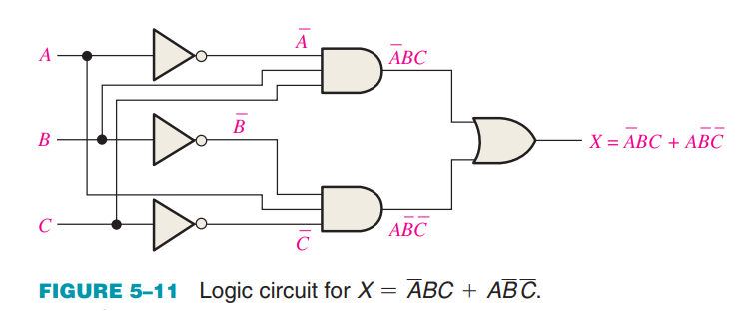
IMPLEMENT COMBINATIONAL LOGIC
From a Truth Table to a Logic Circuit
The Boolean SOP expression obtained from the truth table by ORing the product terms for which X 5 1 is

Slide 22
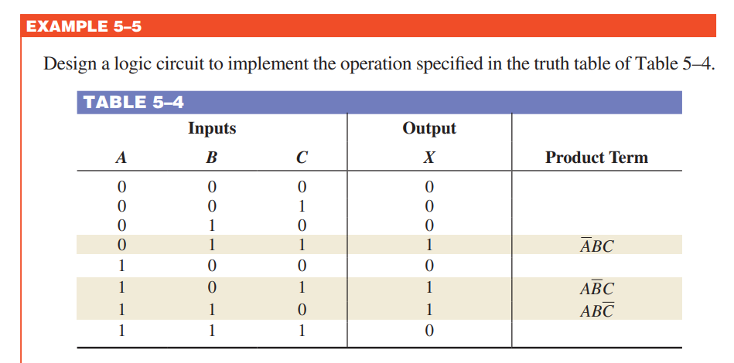
IMPLEMENT COMBINATIONAL LOGIC

Slide 23
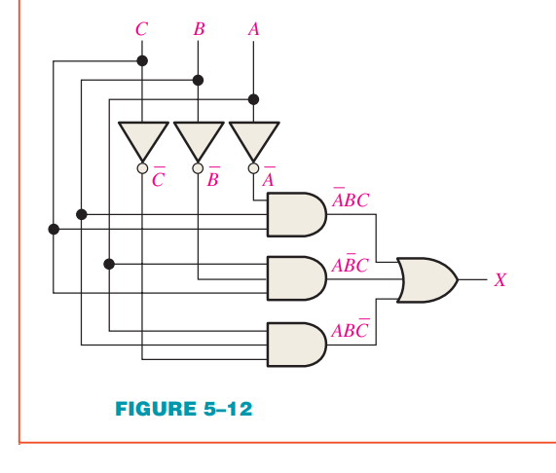
IMPLEMENT COMBINATIONAL LOGIC

Slide 24
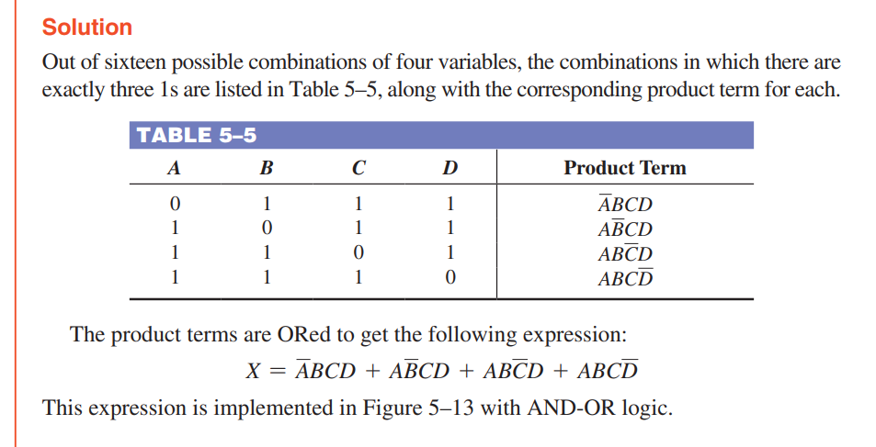
IMPLEMENT COMBINATIONAL LOGIC

Slide 25
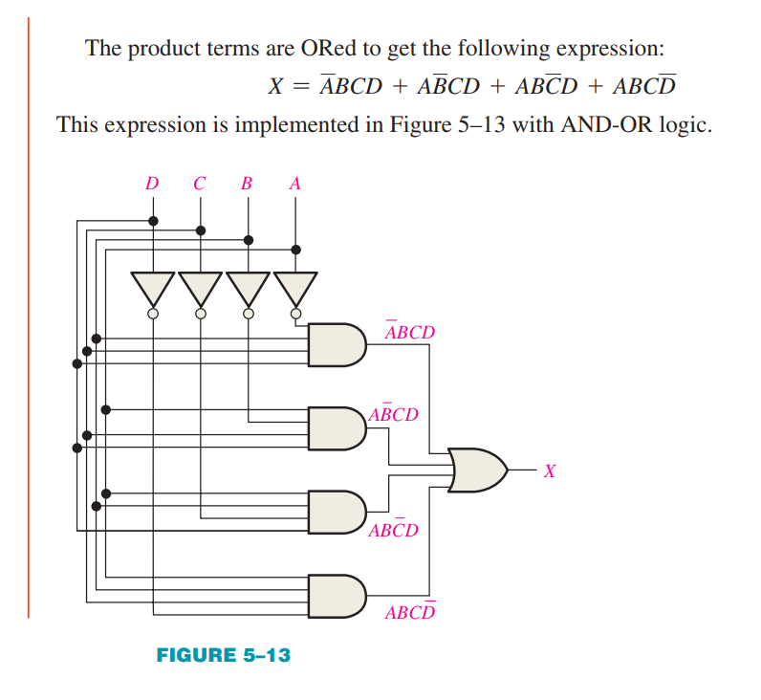

Slide 26
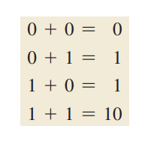
HALF AND FULL ADDER
Adders are important in computers and also in other types of digital systems in which numerical data are processed.
The Half-Adder
Recall the basic rules for binary addition
The operations are performed by a logic circuit called a half-
adder.
The half-adder accepts two binary digits on its inputs and
produces two binary digits on its outputs—a sum bit and a
carry bit.

Slide 27
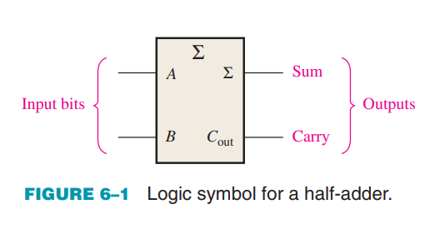
HALF AND FULL ADDER
The Half-Adder
A half-adder is represented by the logic symbol in Figure 6–1.

Slide 28
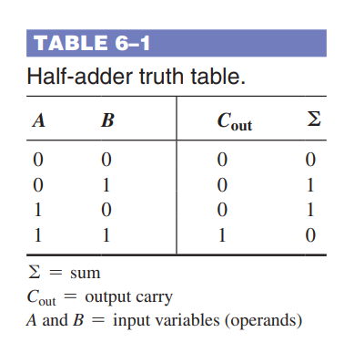
HALF AND FULL ADDER
The Half-Adder Logic :
From the operation of the half-adder as stated in
Table 6–1, expressions can be derived for the sum and
the output carry as functions of the inputs. Notice that
the output carry (Cout) is a 1 only when both A and B
are 1s; therefore, Cout can be expressed as the AND
of the input variables.
C_{out} = AB Equation 6–1

Slide 29
HALF AND FULL ADDER
The Half-Adder Logic :
Now observe that the sum output (Σ) is a 1 only if
the input variables, A and B, are not equal. The sum
can therefore be expressed as the exclusive-OR of the
input variables.
Σ = A ⊕ B Equation 6–2

Slide 30
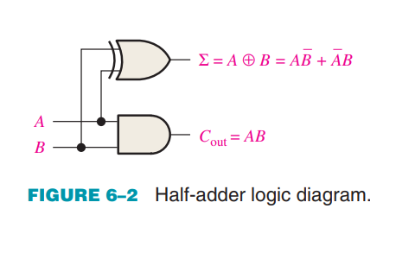
HALF AND FULL ADDER
The Half-Adder Logic :
From Equations 6–1 and 6–2, the logic
implementation required for the half-adder
function can be developed. The output carry is
produced with an AND gate with A and B on
inputs, and the sum output is generated with
an exclusive-OR gate, as shown in Figure 6–2.
Remember that the exclusive-OR can be
implemented with AND gates, an OR gate, and inverters.

Slide 31
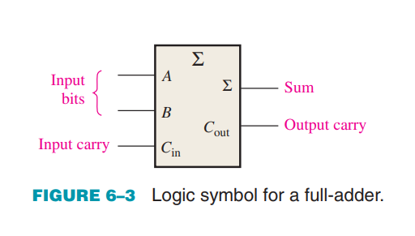
HALF AND FULL ADDER
The Full-Adder :
The second category of adder is the full-adder. The full-adder accepts two input bits and an input carry and generates a sum output and an output carry.
The basic difference between a full-adder
and a half-adder is that the full-adder
accepts an input carry. A logic symbol for
a full-adder is shown in Figure 6–3, and
the truth table in Table 6–2 shows the
operation of a full-adder.

Slide 32
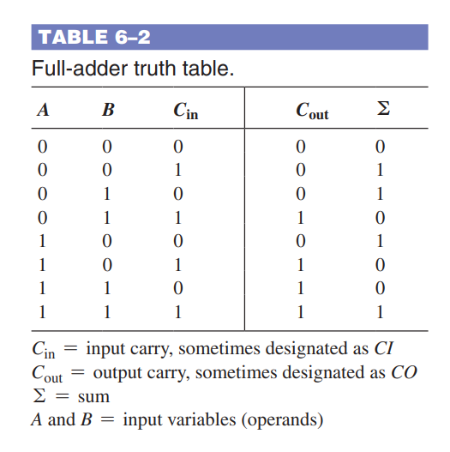
HALF AND FULL ADDER
The Full-Adder Logic :
The full-adder must add the two input
bits and the input carry. From the half-adder
you know that the sum of the input bits
A and B is the exclusive-OR of those two
variables, A ⊕ B. For the input carry (C_{in}) to be
added to the input bits, it must be exclusive-ORed with A ⊕ B, yielding the equation for the sum output of the full-adder.
Σ = (A ⊕ B) ⊕ C_{in} Equation 6–3

Slide 33
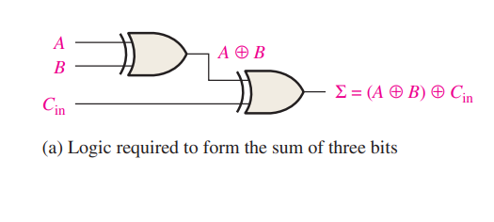
HALF AND FULL ADDER
The Full-Adder Logic :
Σ = A ⊕ B ⊕ C_{in} Equation 6–3
This means that to implement the full-adder sum function, two 2-input exclusive-OR gates can be used. The first must generate the term A B, and the second has as its inputs the output of the first XOR gate and the input carry, as illustrated in Figure 6–4(a).

Slide 34
HALF AND FULL ADDER
The Full-Adder Logic :
The output carry is a 1 when both inputs to the first XOR gate are 1s or when both inputs to the second XOR gate are 1s. You can verify this fact by studying Table 6–2. The output carry of the full-adder is therefore produced by input A ANDed with input B and A B ANDed with Cin. These two terms are ORed, as expressed in Equation 6–4. This function is implemented and combined with the sum logic to form a complete full-adder circuit, as shown in Figure 6–4(b).

Slide 35
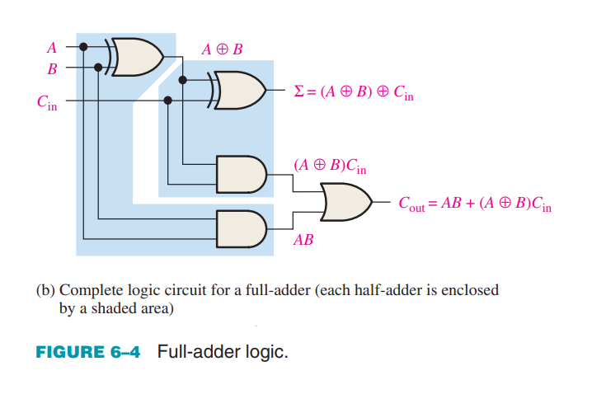
HALF AND FULL ADDER
The Full-Adder Logic :

Slide 36
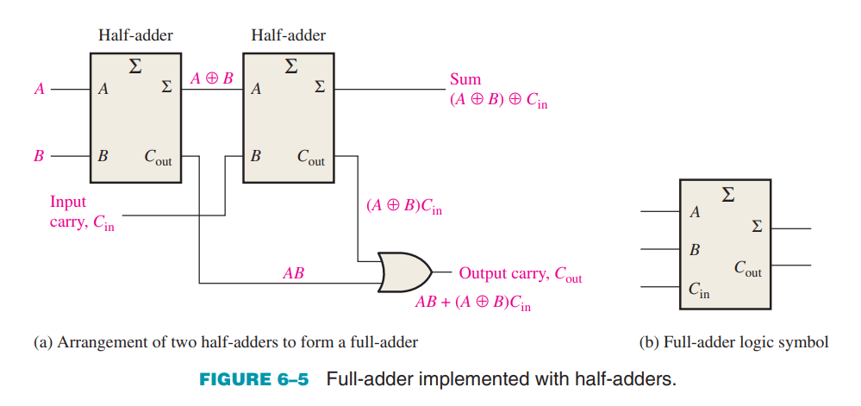
HALF AND FULL ADDER
Notice in Figure 6–4(b) there are two half-adders, connected as shown in the block diagram of Figure 6–5(a), with their output carries ORed. The logic symbol shown in Figure 6–5(b) will normally be used to represent the full-adder

Slide 37
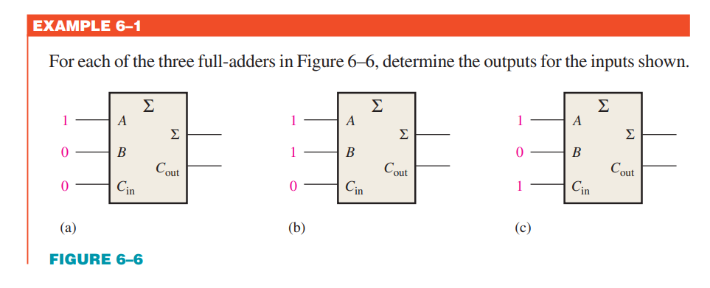
HALF AND FULL ADDER

Slide 38
COMPUTER ARCHITECHTURE FUNDAMENTALS
The Von Neumann Architecture
The von Neumann architecture, shown in figure 5.1, is based on a Central Processing Unit (CPU), interacting with a memory device, receiving data from some input device, and emitting data to some output device.

Slide 39
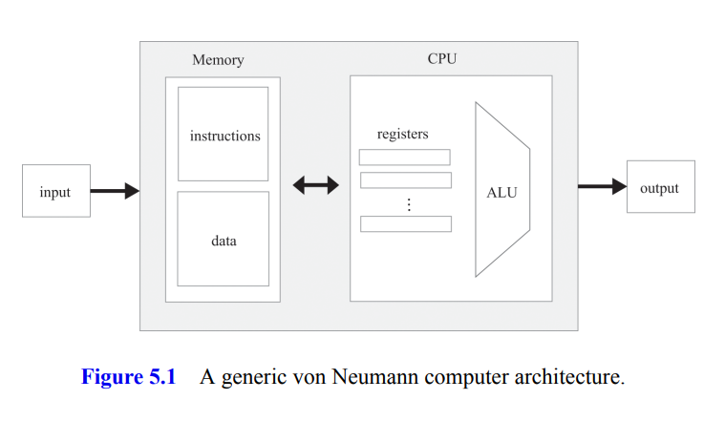
COMPUTER ARCHITECHTURE FUNDAMENTALS

Slide 40
COMPUTER ARCHITECHTURE FUNDAMENTALS
Memory
The computer’s Memory can be discussed from both physical and logical perspectives. Physically, the memory is a linear sequence of addressable, fixed-size registers, each having a unique address and a value. Logically, this address space serves two purposes: storing data and storing instructions. Both the “instruction words” and the “data words” are implemented exactly the same way—as sequences of bits.

Slide 41
COMPUTER ARCHITECHTURE FUNDAMENTALS
Data Memory
High-level programs are designed to manipulate abstract artifacts like variables, arrays, and objects. Yet at the hardware level, these data abstractions are realized by binary values stored in memory registers. In particular, following translation to machine language, abstract array processing and get/set operations on objects are reduced to reading and writing selected memory registers. To read a register, we supply an address and probe the value of the selected register. To write to a register, we supply an address and store a new value in the selected register, overriding its previous value.

Slide 42
COMPUTER ARCHITECHTURE FUNDAMENTALS
Instruction Memory
Before a high-level program can be executed on a target computer, it must first be translated into the machine language of the target computer. Each high-level statement is translated into one or more low-level instructions, which are then written as binary values to a file called the binary, or executable, version of the program.

Slide 43
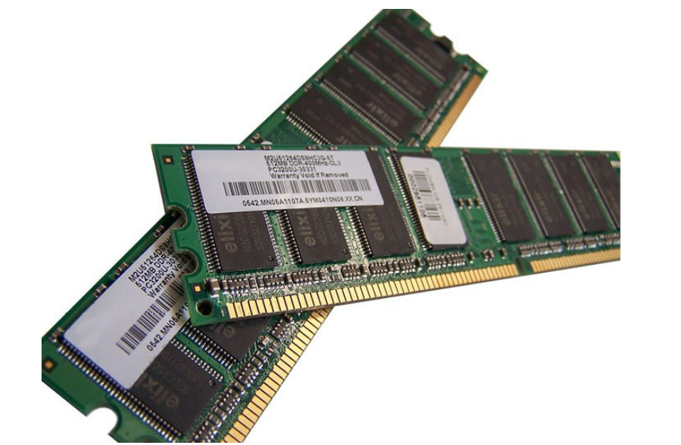
COMPUTER ARCHITECHTURE FUNDAMENTALS
Memory (RAM)

Slide 44
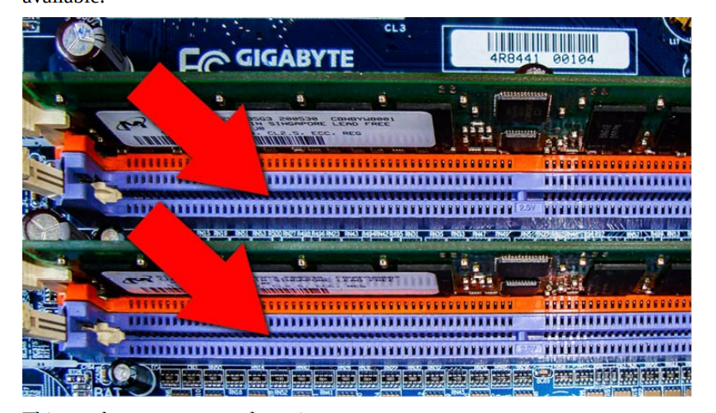
COMPUTER ARCHITECHTURE FUNDAMENTALS
Memory (RAM)

Slide 45
COMPUTER ARCHITECHTURE FUNDAMENTALS
Central Processing Unit (CPU)
The Central Processing Unit (CPU)—the centerpiece of the computer’s architecture—is in charge of executing the instructions of the currently running program. Each instruction tells the CPU which computation to perform, which registers to access, and which instruction to fetch and execute next. The CPU executes these tasks using three main elements: An Arithmetic Logic Unit (ALU), a set of registers, and a control unit.

Slide 46
COMPUTER ARCHITECHTURE FUNDAMENTALS
Arithmetic Logic Unit (ALU)
The ALU chip is built to perform all the low-level arithmetic and logical operations featured by the computer.
Register
CPU uses register to read data , write data and stroe data.

Slide 47
COMPUTER ARCHITECHTURE FUNDAMENTALS
Control :
A computer instruction is a structured package of agreed-upon micro-codes, that is, sequences of one or more bits designed to signal different devices what to do. Thus, before an instruction can be executed, it must first be decoded into its micro-codes. Next, each micro-code is routed to its designated hardware device (ALU, registers, memory) within the CPU, where it tells the device how to partake in the overall execution of the instruction.

Slide 48
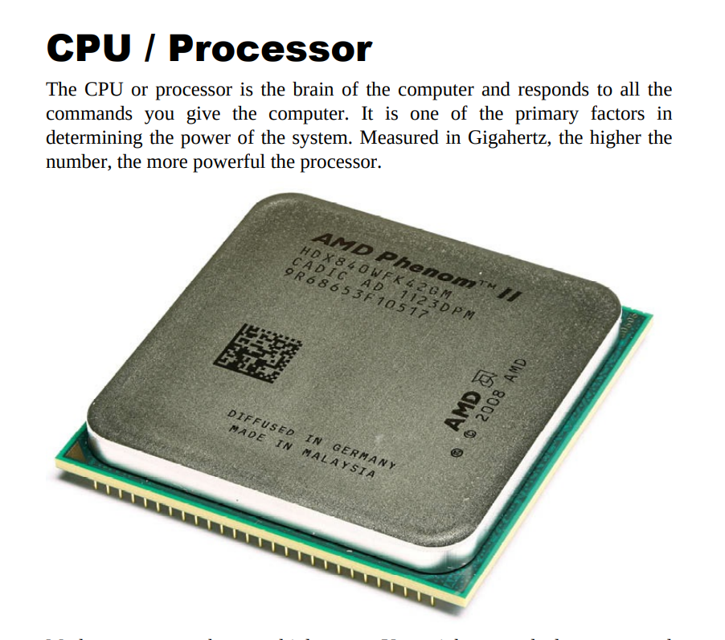
COMPUTER ARCHITECHTURE FUNDAMENTALS

Slide 49
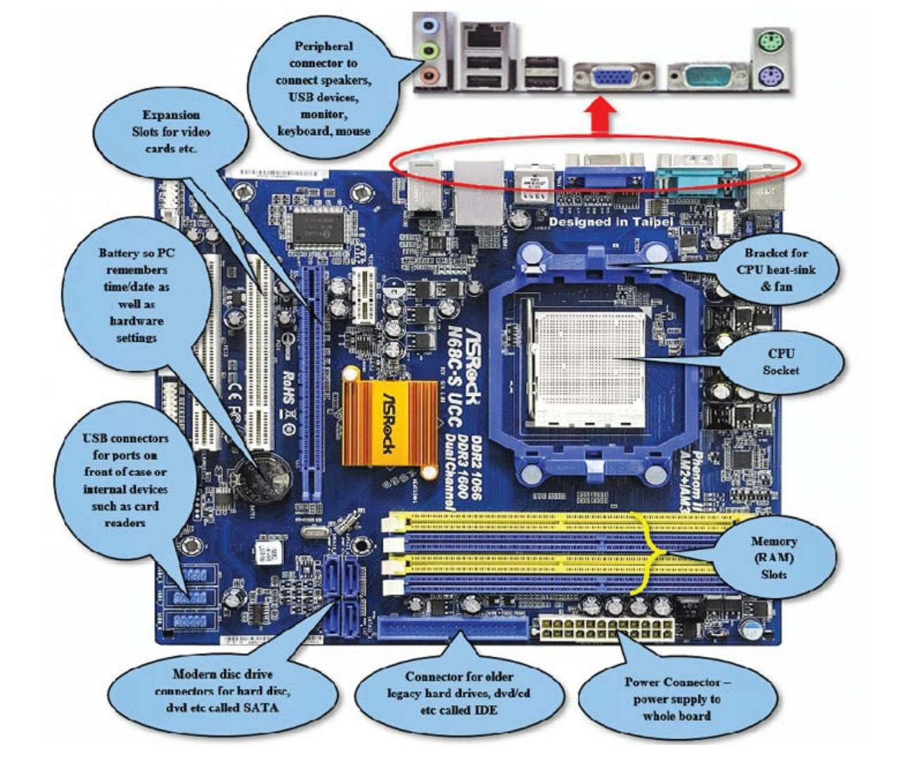
COMPUTER ARCHITECHTURE FUNDAMENTALS

