Slide 1
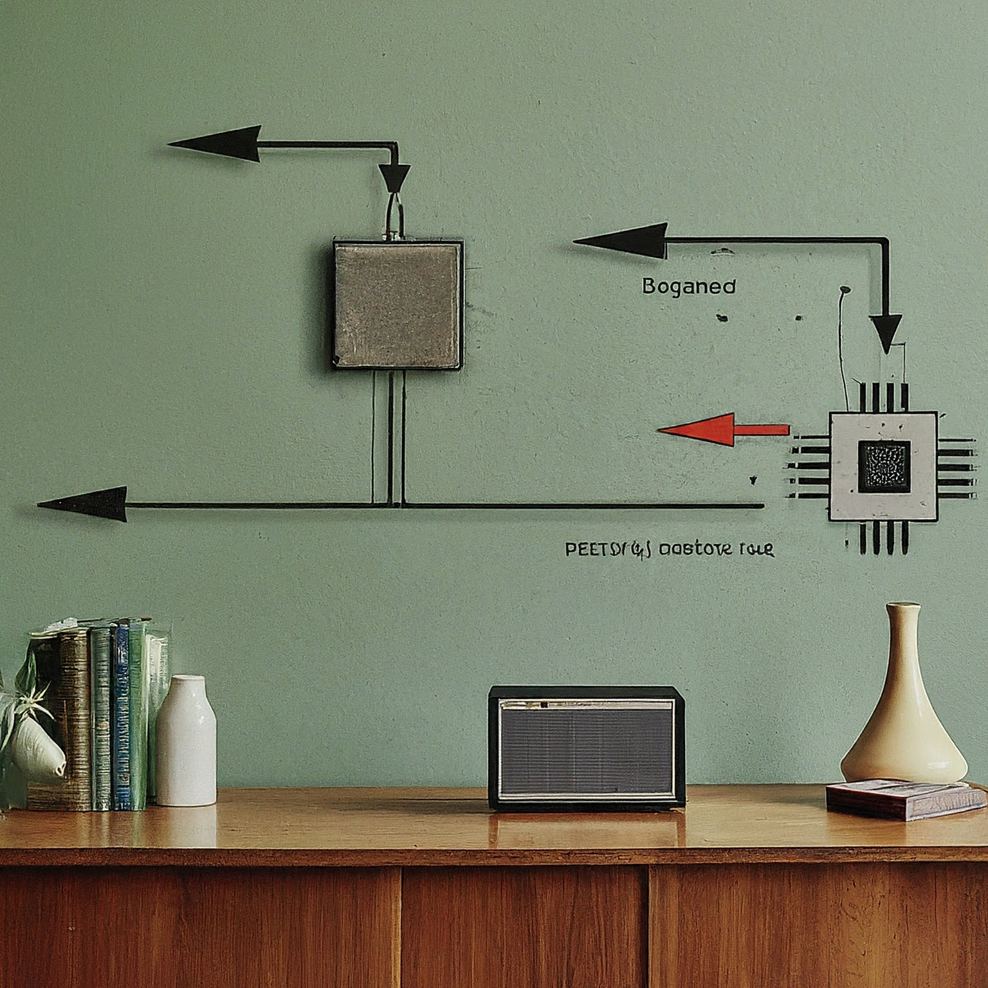
COMPUTER ARCITECTURE
DTI 112
LECTURE 03
AND OPERATING SYSTEM

Slide 2
DTI 112 COMPUTER ARCHITECTURE
Link to powerpoint handout :
https://kbucomsci.weebly.com
QR-Code to handout :

Slide 3
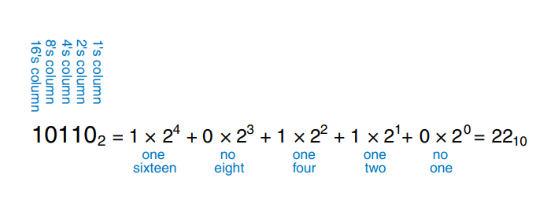
BINARY NUMBER
512 | 256 | 128 | 64 | 32 | 16 | 8 | 4 | 2 | 1
2⁹ | 2⁸ | 2⁷ | 2⁶ | 2⁵ | 2⁴ | 2³ | 2² | 2¹ | 2⁰

Slide 4
BINARY NUMBER

Slide 5
BINARY NUMBER

Slide 6
BINARY NUMBER

Slide 7
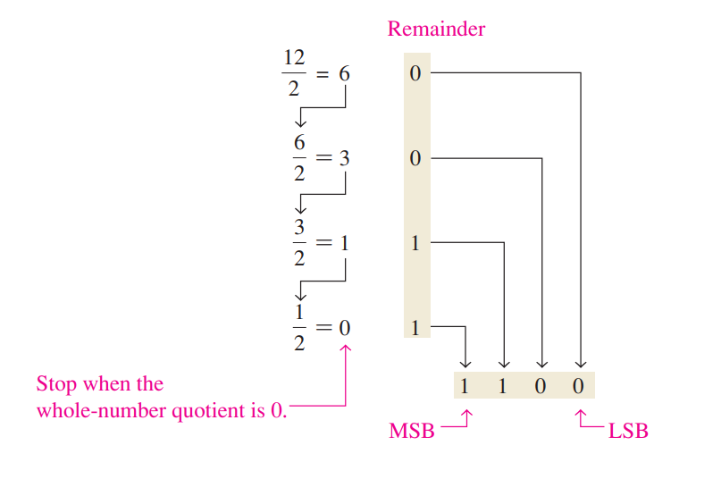
DECIMAL TO BINARY CONVERSION

Slide 8
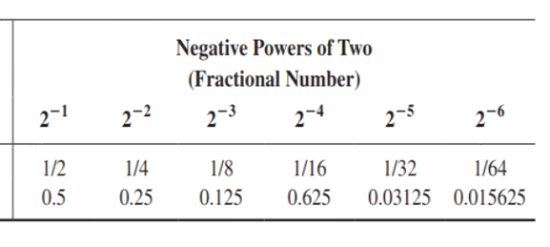
DECIMAL TO BINARY CONVERSION

Slide 9
DECIMAL TO BINARY CONVERSION
Converting Decimal Fractions to Binary

Slide 10
BINARY ARITHMATIC

Slide 11
REPRESENTATION OF NEGATIVE NUMBERS

Slide 12
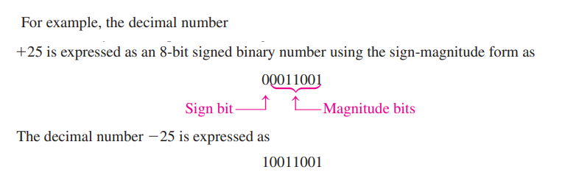
REPRESENTATION OF NEGATIVE NUMBERS

Slide 13
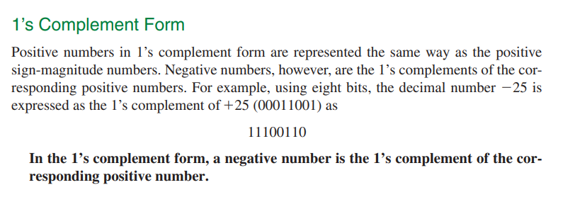
REPRESENTATION OF NEGATIVE NUMBERS

Slide 14
REPRESENTATION OF NEGATIVE NUMBERS

Slide 15
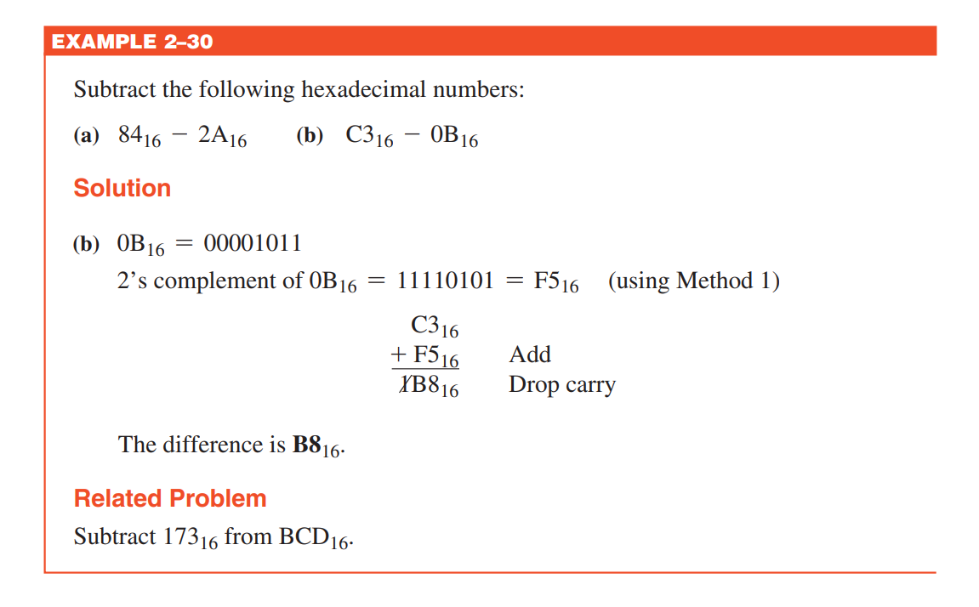
OCTAL NUMBER SYSTEM
The octal number system is composed of eight digits, which are 0, 1, 2, 3, 4, 5, 6, 7 To count above 7, begin another column and start over:
10, 11, 12, 13, 14, 15, 16, 17, 20, 21, …

Slide 16
OCTAL-TO-DECIMAL CONVERSION
Since the octal number system has a base of eight, each successive digit position is an increasing power of eight, beginning in the right-most column with 8⁰ .

Slide 17
OCTAL NUMBER
512 | 256 | 128 | 64 | 32 | 16 | 8 | 4 | 2 | 1
2⁹ | 2⁸ | 2⁷ | 2⁶ | 2⁵ | 2⁴ | 2³ | 2² | 2¹ | 2⁰
8³ | - | - | 8² | - | - | 8¹ | - | - | 8⁰

Slide 18
OCTAL-TO-DECIMAL CONVERSION
The evaluation of an octal number in terms of its decimal equivalent is accomplished by multiplying each digit by its weight and summing the products, as illustrated here for 2374₈.

Slide 19
DECIMAL -TO- OCTAL CONVERSION
A method of converting a decimal number to an octal number is the repeated divisionby-8 method, which is similar to the method used in the conversion of decimal numbers to binary or to hexadecimal.

Slide 20
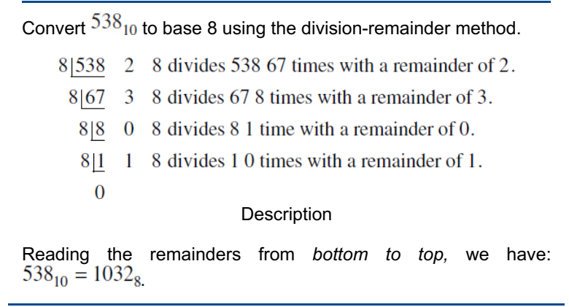
DECIMAL -TO- OCTAL CONVERSION

Slide 21
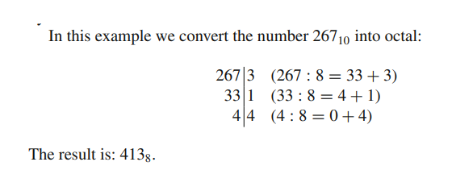
DECIMAL -TO- OCTAL CONVERSION

Slide 22
OCTAL-TO-BINARY CONVERSION
Because each octal digit can be represented by a 3-bit binary number, it is very easy to convert from octal to binary. Each octal digit is represented by three bits as shown

Slide 23
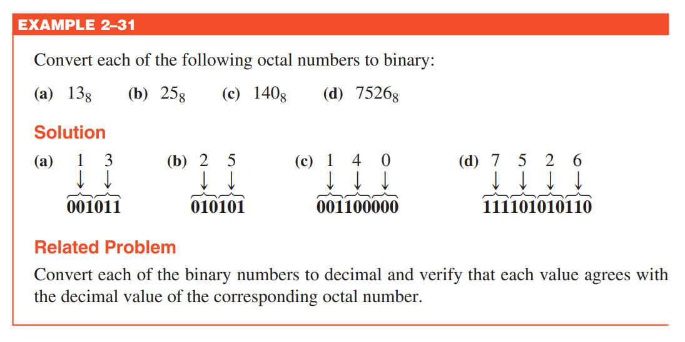
OCTAL-TO-BINARY CONVERSION

Slide 24
BINARY-TO-OCTAL CONVERSION
The procedure is as follows: Start with the right-most group of three bits and, moving from right to left, convert each 3-bit group to the equivalent octal digit.

Slide 25
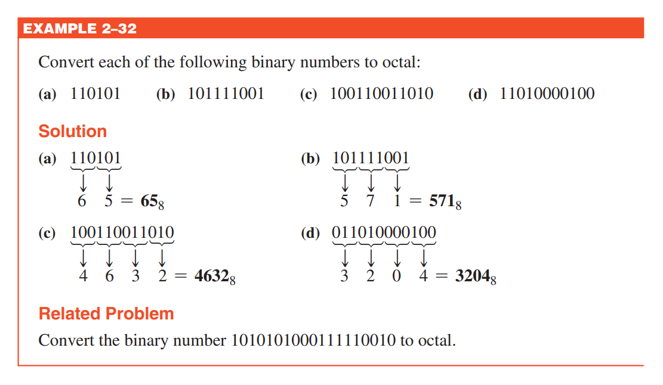
BINARY-TO-OCTAL CONVERSION

Slide 26
ADDING OCTAL NUMBER
To add octal numbers, you align the numbers by their least significant digit (rightmost digit) and add them column by column, just like in decimal addition. If the sum of a column exceeds 7, you carry over to the next column.

Slide 27
ADDING OCTAL NUMBER
To add octal numbers, you align the numbers by their least significant digit (rightmost digit) and add them column by column, just like in decimal addition. If the sum of a column exceeds 7, you carry over to the next column. If the sum of a column is 8 or greater, subtract 8 from the sum and carry 1 to the next column to the left.

Slide 28
ADDING OCTAL NUMBER
1 5 7
+ 2 4 6
----------
( 4 2 5 )₈
Adding Octal Numbers (157)₈ and (246)₈ :
Add the rightmost column:7 + 6 = 13 (in decimal) Since 13 is greater than 7, subtract 8 and carry 1: 13 - 8 = 5 (write 5, carry 1)
Add the next column with carry:5 + 4 + 1 (carry) = 10 (in decimal) Since 10 is greater than 7, subtract 8 and carry 1: 10 - 8 = 2 (write 2, carry 1)
Add the leftmost column with carry: 1 + 2 + 1 (carry) = 4 (in decimal)

Slide 29
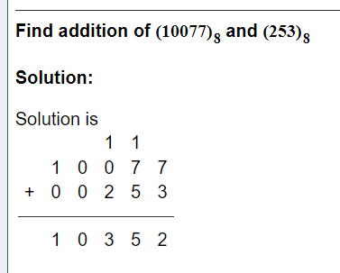
ADDING OCTAL NUMBER

Slide 30
SUBTRACTING OCTAL NUMBER
Subtracting octal numbers involves borrowing, just like in decimal subtraction. If the digit being subtracted is larger than the digit from which it is being subtracted, you need to borrow from the next column.

Slide 31
SUBTRACTING OCTAL NUMBER
Subtracting Octal Numbers (157)₈ from (246)₈ :
Subtract the rightmost column:6 - 7 (cannot do because 6 is less than 7, so we borrow) Borrow 1 from the next column: (4 - 1 = 3 in the next column, 6 + 8 = 14) 14 - 7 = 5 Subtract the next column with the borrow: 3 - 5 (cannot do because 3 is less than 5, so we borrow) Borrow 1 from the next column: (2 - 1 = 1 in the next column, 3 + 8 = 11) 11 - 5 = 4 Subtract the leftmost column:1 - 1 = 0
2 4 6
- 1 5 7
---------
0 4 5

Slide 32
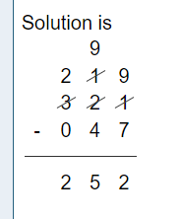
SUBTRACTING OCTAL NUMBER
Find subtraction of (321)₈ and (47)₈ :

Slide 33
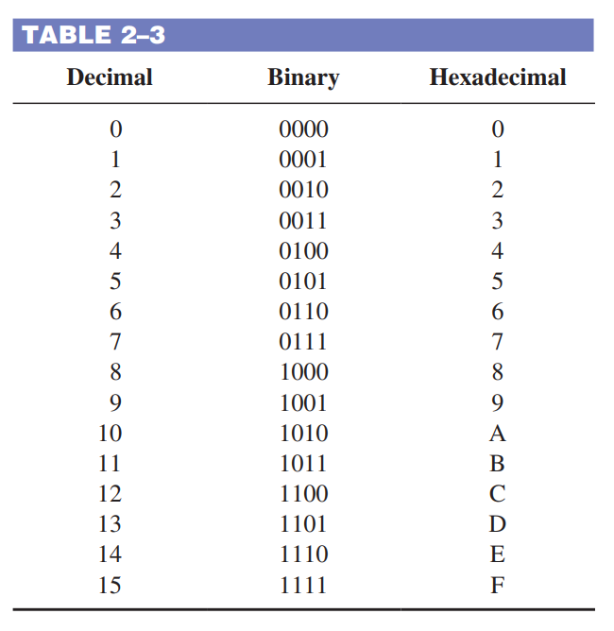
HEXADECIMAL NUMBER
The hexadecimal number system has sixteen characters. The hexadecimal number system has a base of sixteen; that is, it is composed of 16 numeric and alphabetic characters. Each hexadecimal digit represents a 4-bit binary number (as listed in Table 2–3).

Slide 34
HEXADECIMAL NUMBER
Counting in Hexadecimal
How do you count in hexadecimal once you get to F? Simply start over with another column and continue as follows:
D, E, F, 10, 11, 12, 13, 14, 15, 16, 17, 18, 19, 1A, 1B, 1C, 1D, 1E, 1F, 20, 21, 22, 23, 24, 25, 26, 27, 28, 29, 2A, 2B, 2C, 2D, 2E, 2F, 30, 31,…
With two hexadecimal digits, you can count up to FF16, which is decimal 255.

Slide 35
BINARY-TO-HEX CONVERSION
Converting a binary number to hexadecimal is a straightforward procedure. Simply break the binary number into 4-bit groups, starting at the right-most bit and replace each 4-bit group with the equivalent hexadecimal symbol.

Slide 36
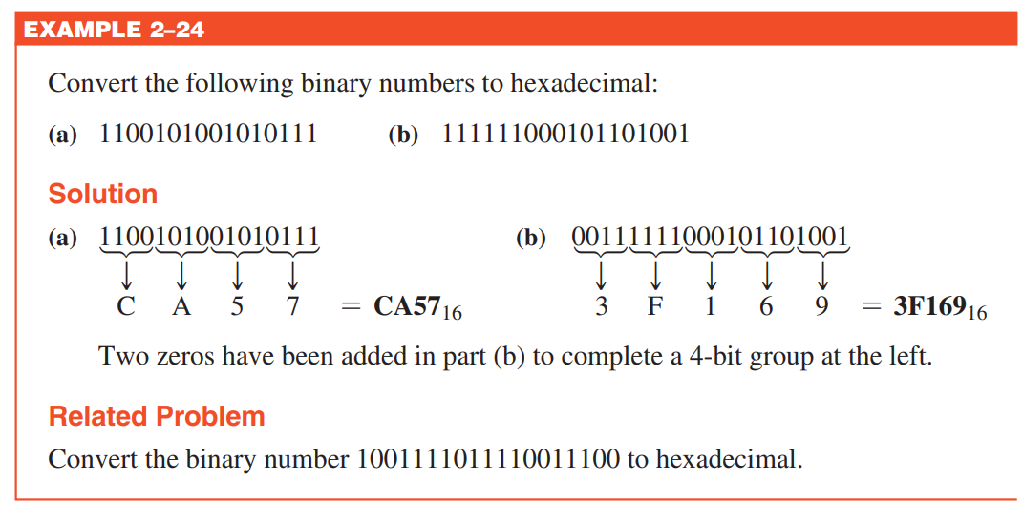
BINARY-TO-HEX CONVERSION

Slide 37
HEX-TO-BINARY CONVERSION
To convert from a hexadecimal number to a binary number, reverse the process and replace each hexadecimal symbol with the appropriate four bits.

Slide 38
HEX-TO-BINARY CONVERSION

Slide 39
HEX-TO-DECIMAL CONVERSION
One way to find the decimal equivalent of a hexadecimal number is to first convert the hexadecimal number to binary and then convert from binary to decimal.

Slide 40
HEX-TO-DECIMAL CONVERSION

Slide 41
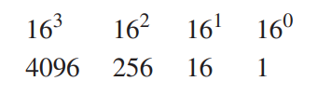
HEX-TO-DECIMAL CONVERSION
Another way to convert a hexadecimal number to its decimal equivalent is to multiply the decimal value of each hexadecimal digit by its weight and then take the sum of these products. The weights of a hexadecimal number are increasing powers of 16 (from right to left). For a 4-digit hexadecimal number, the weights are

Slide 42
HEX-TO-DECIMAL CONVERSION

Slide 43
DECIMAL-TO-HEX CONVERSION
Repeated division of a decimal number by 16 will produce the equivalent hexadecimal number, formed by the remainders of the divisions. The first remainder produced is the least significant digit (LSD). Each successive division by 16 yields a remainder that becomes a digit in the equivalent hexadecimal number.

Slide 44
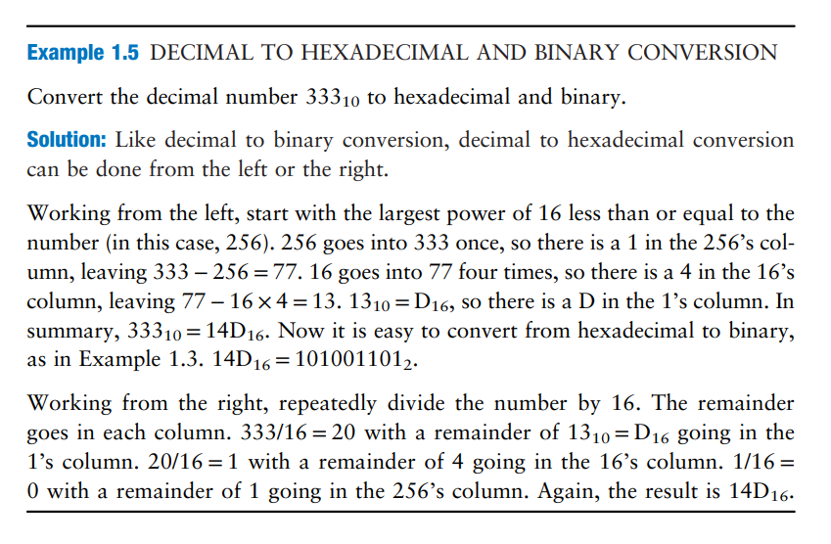
DECIMAL-TO-HEX CONVERSION

Slide 45
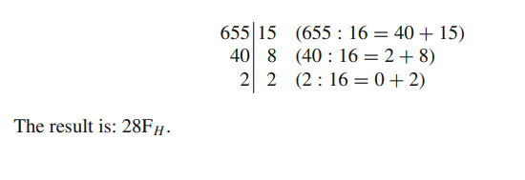
DECIMAL-TO-HEX CONVERSION
In the following example, the number 655₁₀ is converted into hexadecimal.

Slide 46
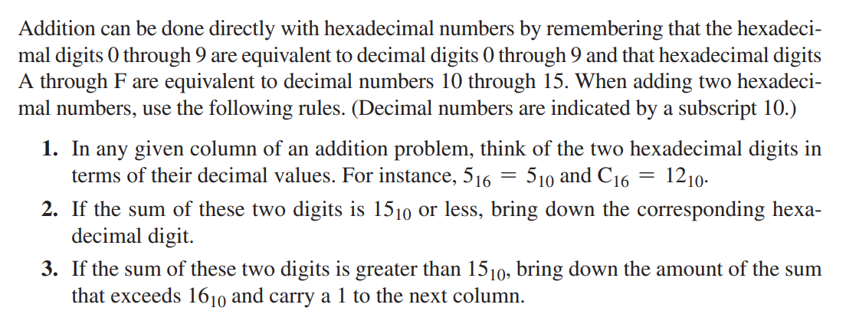
HEXADECIMAL ADDITION

Slide 47
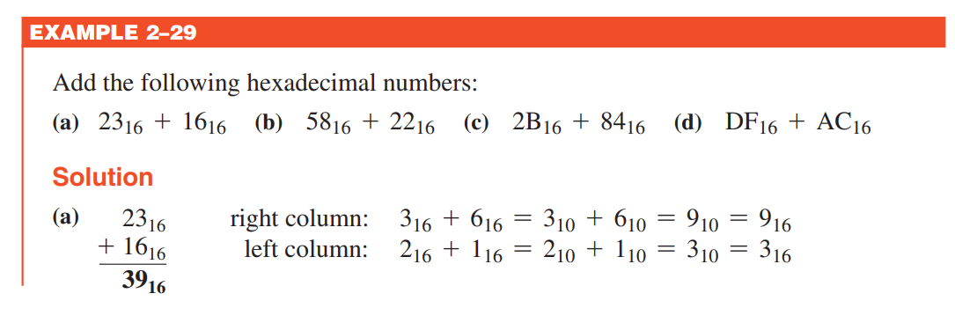
HEXADECIMAL ADDITION

Slide 48
HEXADECIMAL ADDITION

Slide 49
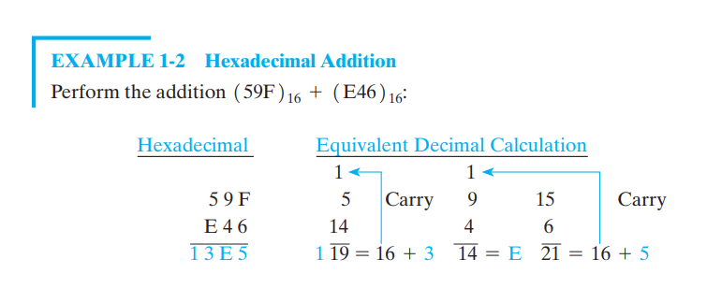
HEXADECIMAL ADDITION

Slide 50
HEXADECIMAL SUBTRACTION
Hexadecimal (or hex) numbers are base-16, which means they use digits from 0 to 15. The digits 10 to 15 are represented by the letters A to F, respectively. Subtraction of hexadecimal numbers follows similar principles to decimal subtraction but involves base-16 arithmetic. Borrow if Needed: If the top digit is smaller than the bottom digit, borrow 1 from the next column to the left. In hexadecimal, borrowing 1 is equivalent to adding 16 to the current digit.

Slide 51
HEXADECIMAL SUBTRACTION
Subtracting Hexadecimal Numbers (1F4 )₁₆ from (2B8)₁₆ :
Subtract the rightmost column: Subtract 4 from 8 (in decimal: 8 - 4 = 4) No need to borrow.Write down the result: 4 Subtract the next column: Subtract F (15 in decimal) from B (11 in decimal). Since 11 is less than 15, we need to borrow.Borrow 1 from the next column: (2 - 1 = 1 in the next column, and B + 16 = 27 in decimal).Now subtract: 27 - 15 = 12 (C in hexadecimal).Write down the result: CSubtract the leftmost column:Subtract 1 from 1: (1 - 1 = 0).Write down the result: 0
2 B 8
- 1 F 4
---------
C 4

Slide 52
HEXADECIMAL SUBTRACTION
7 C 1
- 3 A 7
---------
4 1 A
Subtracting Hexadecimal Numbers (3A7)₁₆ from (7C1)₁₆ :
Subtract the rightmost column: Subtract 7 from 1 (in decimal: 1 - 7). Since 1 is less than 7, borrow from the next column: (C - 1 = B, and 1 + 16 = 17). Now subtract : 17 - 7 = 10 (A in hexadecimal).Write down the result: ASubtract the next column:Subtract A (10 in decimal) from B (11 in decimal). No need to borrow.Write down the result: 1Subtract the leftmost column:Subtract 3 from 7 (in decimal: 7 - 3 = 4).Write down the result: 4

