Slide 1
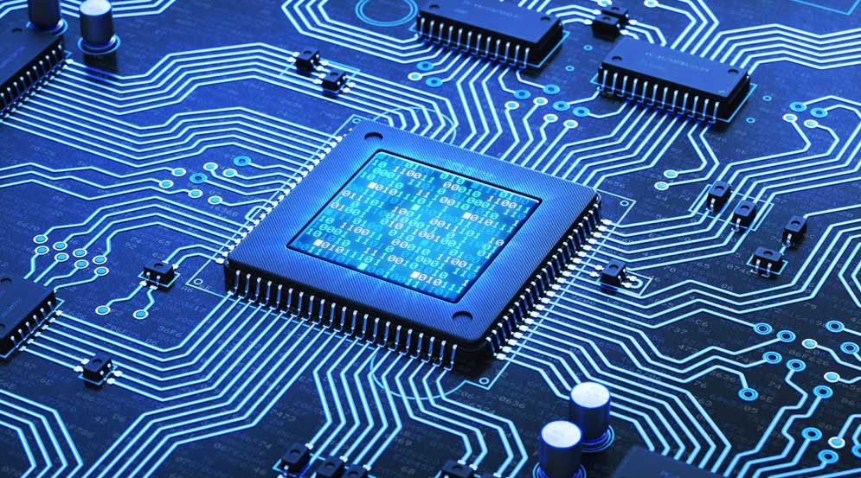
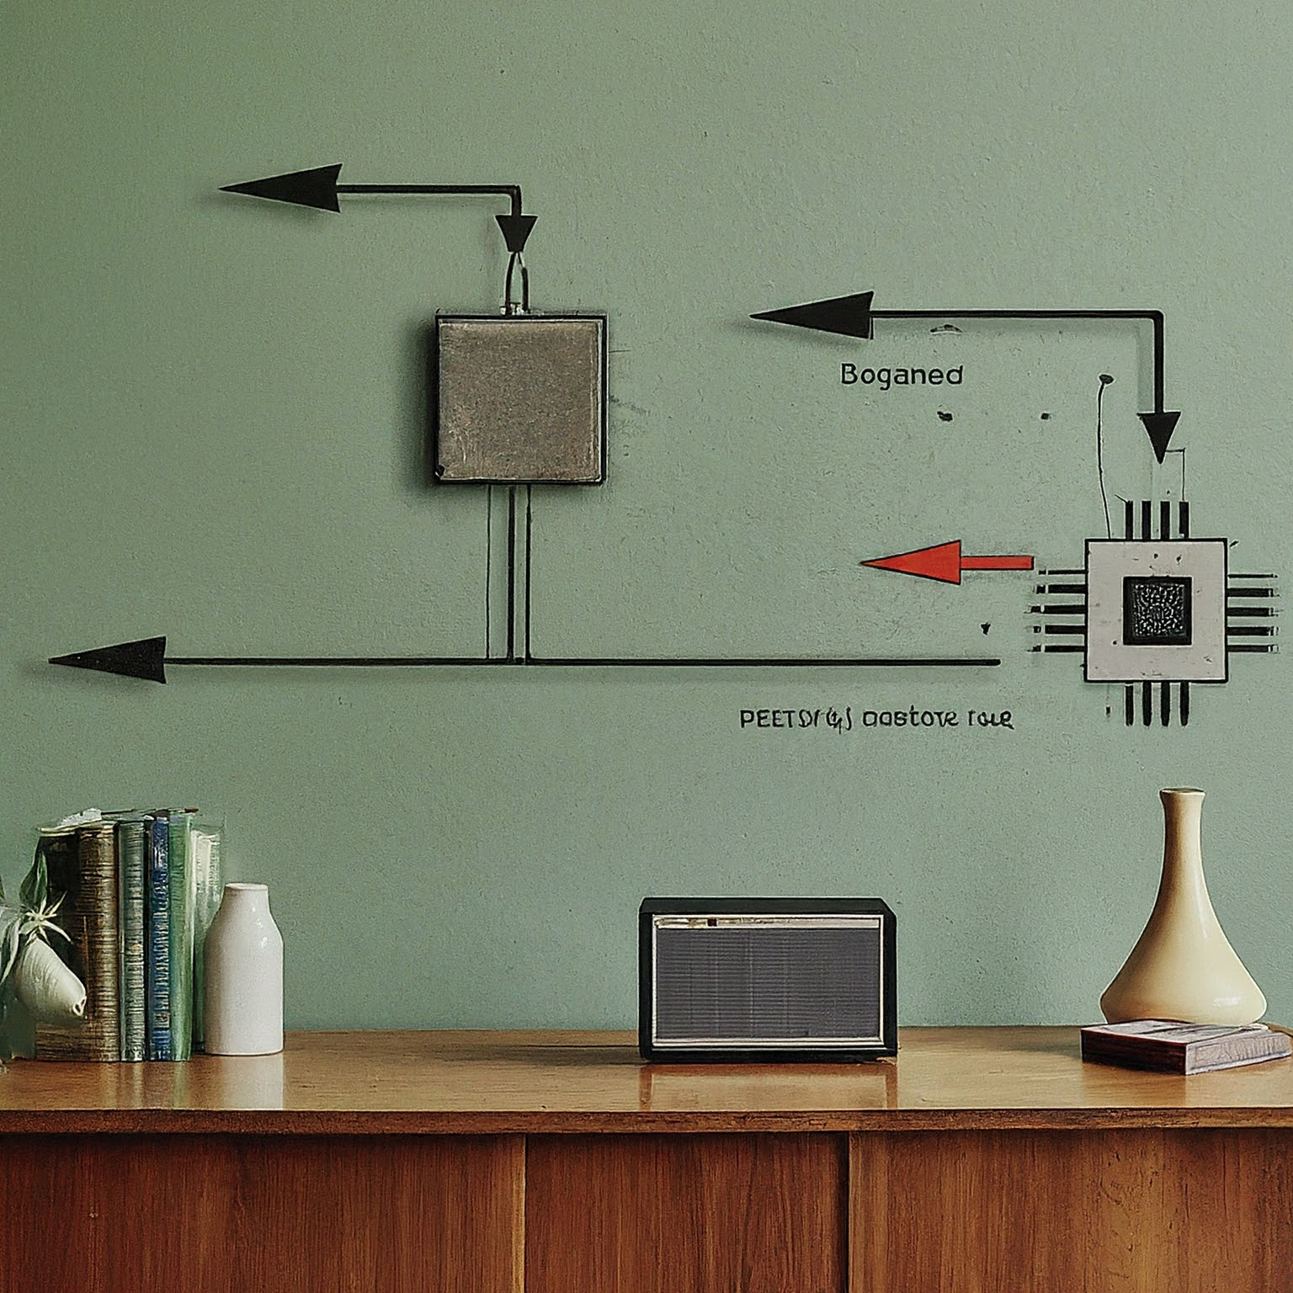
COMPUTER ARCITECTURE
DTI 112
LECTURE 02
AND OPERATING SYSTEM

Slide 2
DTI 112 COMPUSTER ARCHITECTURE
Link to powerpoint handout :
https://kbucomsci.weebly.com
QR-Code to handout :

Slide 3
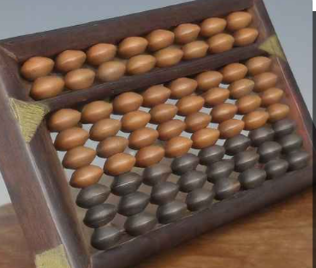
EVOLUTION OF COMPUTER ARCHITECTURE
Early Calculating Devices
Our story begins with the abacus, This early device used rows of beads to represent numbers and facilitated basic arithmetic operations like addition, subtraction.

Slide 4
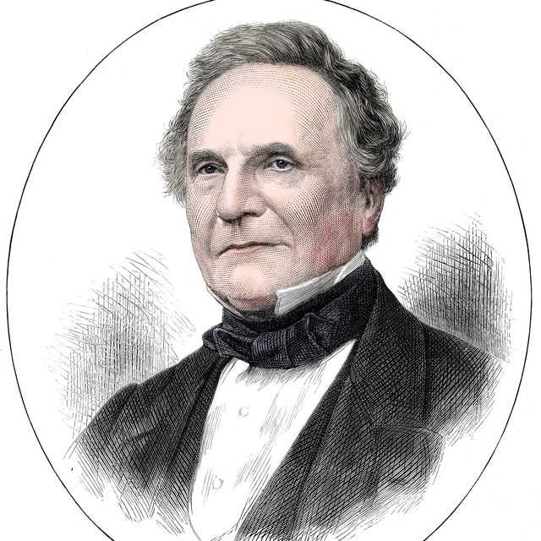
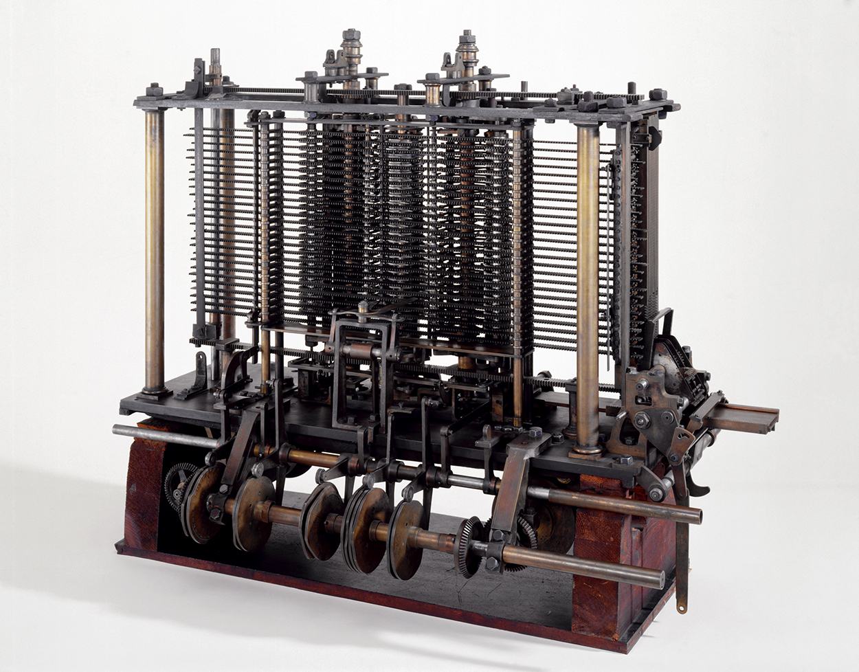
EVOLUTION OF COMPUTER ARCHITECTURE
Early Mechanical Computers (1837)
Charles Babbage: Known as the 'father of the computer,' Babbage designed the first automatic mechanical computer, the Analytical Engine, which contained basic components such as an ALU, control flow in the form of conditional branching and loops, and integrated memory.

Slide 5
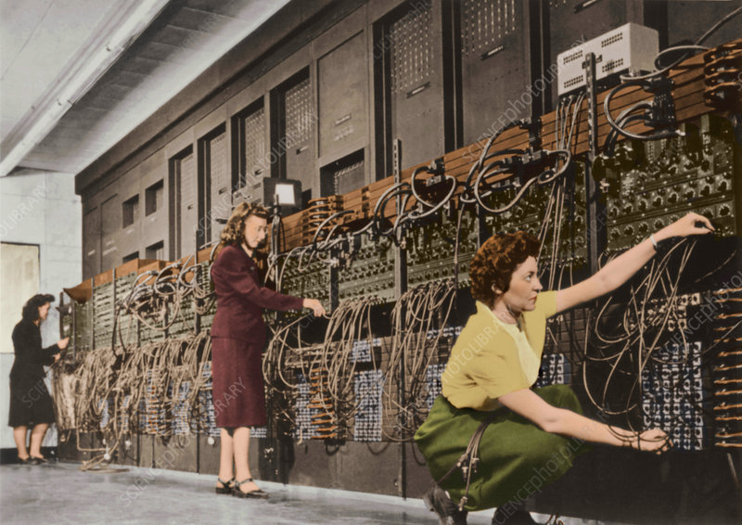
EVOLUTION OF COMPUTER ARCHITECTURE
The Birth of Electronic Computers, The invention of the electronic vacuum tube in the early 20th century replaced the mechanical gears of the Analytical Engine. The ENIAC, built during World War II, requiring thousands of vacuum tubes, the ENIAC represented a major breakthrough as the first electronic general-purpose computer capable of performing complex calculations at electronic speeds.

Slide 6
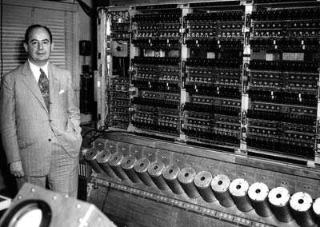
EVOLUTION OF COMPUTER ARCHITECTURE
Von Neumann Architecture (1945)
John von Neumann: Proposed the stored-program concept, which became the foundation for most computer architectures.
Introduction of a single memory space for both instructions and data, leading to the Von Neumann bottleneck.

Slide 7
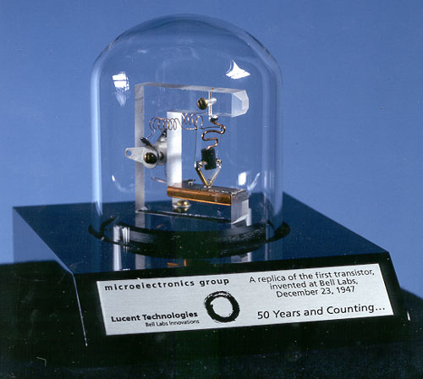
EVOLUTION OF COMPUTER ARCHITECTURE
Transistor Computers (1950s)
Bell Labs: Developed the transistor, replacing vacuum tubes in computers, significantly reducing size, heat, and power consumption.
The transition from vacuum tubes to transistors marked the beginning of the second generation of computers.
A replica of the first working transistor, a point-contact transistor invented in 1947

Slide 8
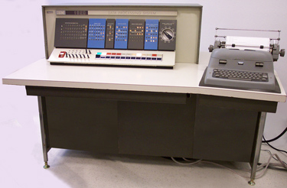
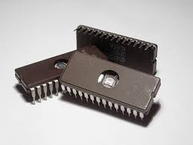
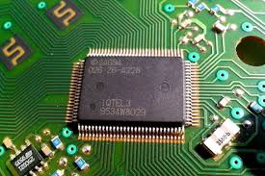
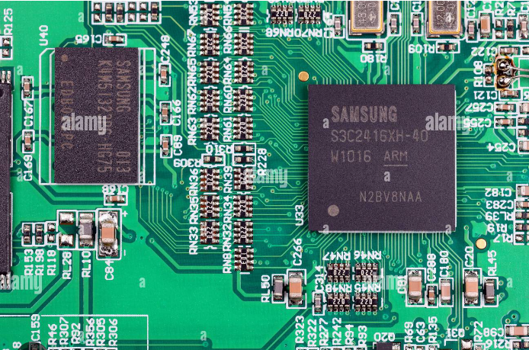
EVOLUTION OF COMPUTER ARCHITECTURE

Slide 9
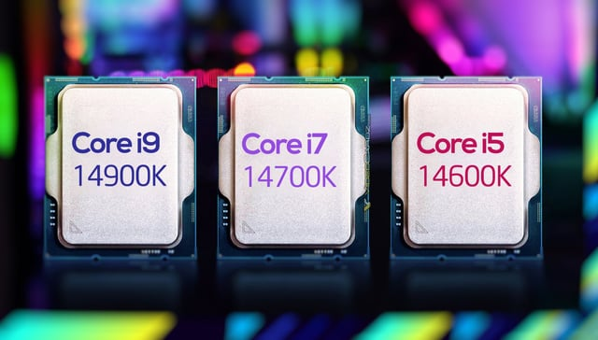
EVOLUTION OF COMPUTER ARCHITECTURE
Parallel Processing and Multi-Core Processors (1990s-Present)
Advancements in Multi-Core Technology: CPUs began integrating multiple cores to handle parallel processing more effectively.
Improvement in processing power and efficiency, leading to the current trend of multi-core processors in consumer and enterprise systems.
Intel Multi-Core : Gen 14

Slide 10
INTRODUCTION TO Von Neumann Architecture
Fundamental Principles of Von Neumann Architecture
Stored Program Concept
The core principle of the Von Neumann architecture is the stored program concept. This means that instructions for the computer (the program) and the data it processes are stored in the same memory space. This allows the computer to be reprogrammed simply by changing the instructions in memory, rather than reconfiguring the hardware.

Slide 11
INTRODUCTION TO Von Neumann Architecture
Fundamental Principles of Von Neumann Architecture
Sequential Instruction Execution
Another key principle is that instructions are executed sequentially. The computer fetches an instruction from memory, decodes it to understand what needs to be done, executes the instruction, and then moves to the next instruction. This cycle repeats continuously, enabling the computer to perform complex tasks by breaking them down into simpler sequential steps.

Slide 12
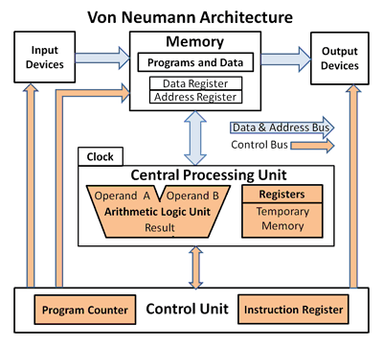
CORE COMPONENTS OF VON NEUMANN ARCHITECTURE
The Central Processing Unit (CPU) acts as the brain of the entire system. It's responsible for fetching, decoding, and executing instructions that make the computer work. It consists of the Control Unit (CU), the Arithmetic Logic Unit (ALU), and various registers. The CPU executes instructions from the program stored in memory.

Slide 13
CORE COMPONENTS OF VON NEUMANN ARCHITECTURE
Memory
Memory in a Von Neumann architecture stores both data and instructions. This unified memory model simplifies the design but can lead to contention between instruction fetches and data operations, a phenomenon known as the Von Neumann bottleneck.

Slide 14
CORE COMPONENTS OF VON NEUMANN ARCHITECTURE
Input/Output (I/O) System
The I/O system allows the computer to interact with the outside world. It includes devices like keyboards, monitors, and storage drives. The I/O system is connected to the CPU and memory through buses.

Slide 15
CORE COMPONENTS OF VON NEUMANN ARCHITECTURE
Buses
Buses are communication pathways that transfer data between different components of the computer. The main types of buses in a Von Neumann architecture are the Data Bus, Address Bus, and Control Bus.

Slide 16
CORE COMPONENTS OF VON NEUMANN ARCHITECTURE
CPU: Control Unit, Arithmetic Logic Unit (ALU), Registers
Control Unit (CU): Directs the operation of the CPU by generating control signals that manage the execution of instructions.
Arithmetic Logic Unit (ALU): Performs arithmetic and logical operations on data.
Registers: Small, fast storage locations within the CPU that hold data and instructions temporarily during processing.

Slide 17
CORE COMPONENTS OF VON NEUMANN ARCHITECTURE
Memory: RAM, ROM, Cache
Random Access Memory (RAM): Volatile memory used to store data and instructions that the CPU needs while performing tasks.
Read-Only Memory (ROM): Non-volatile memory that contains essential instructions for booting up the computer.
Cache: A small, fast memory located close to the CPU that stores frequently accessed data and instructions to speed up processing.

Slide 18
CORE COMPONENTS OF VON NEUMANN ARCHITECTURE
Buses: Data Bus, Address Bus, Control Bus
Data Bus: Transfers data between the CPU, memory, and I/O devices.
Address Bus: Carries the addresses of data and instructions between the CPU and memory.
Control Bus: Transmits control signals between the CPU and other components to coordinate their actions.

Slide 19
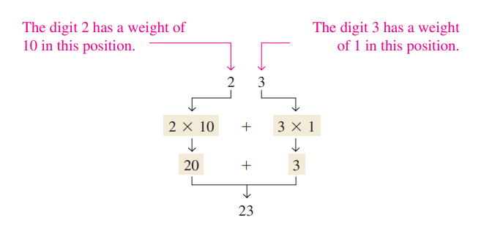
NUMBER SYSTEM
Decimal Number :
In the decimal number system each of the ten digits, 0 through 9, represents a certain quantity.

Slide 20
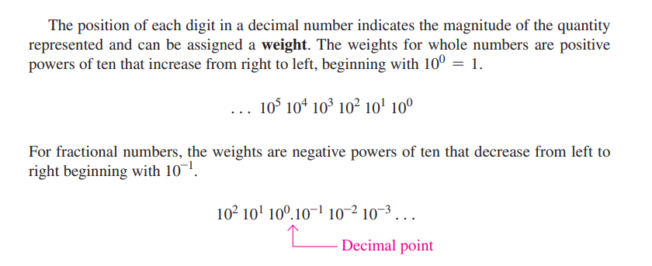
DECIMAL NUMBER

Slide 21
DECIMAL NUMBER

Slide 22
DECIMAL NUMBER

Slide 23
DECIMAL NUMBER

Slide 24
DECIMAL NUMBER
When counting in the decimal system, we start with 0 in the units position and take each symbol (digit) in progression until we reach 9. Then we add a 1 to the next higher position and start over with 0 in the first position

Slide 25
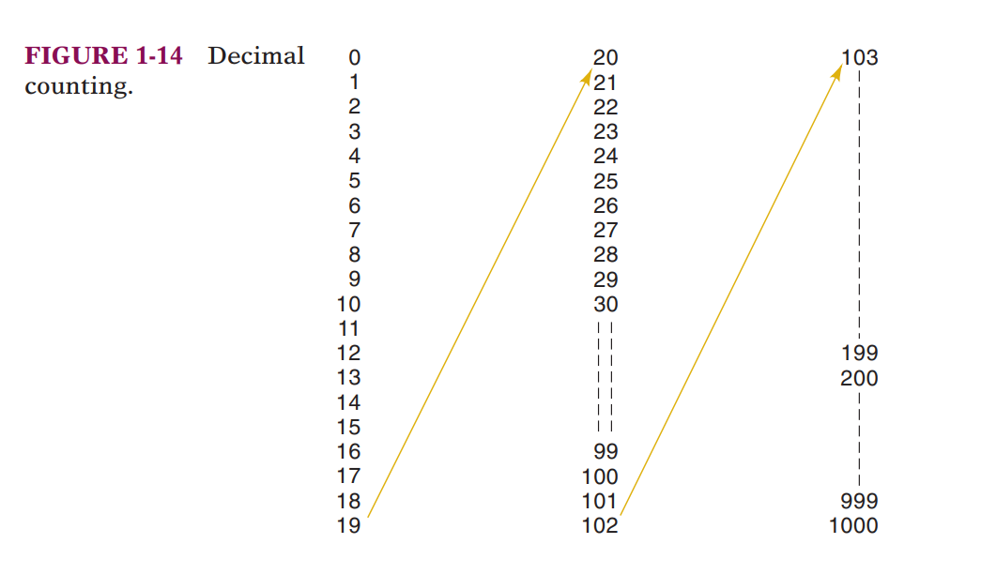
DECIMAL NUMBER

Slide 26
BINARY NUMBER
Bits represent one of two values, 0 or 1, and are joined together to form binary numbers. Each column of a binary number has twice the weight of the previous column, so binary numbers are base 2. In binary, the column weights (again from right to left) are 1, 2, 4, 8, 16, 32, 64, 128, 256, 512, 1024, 2048, 4096, 8192, 16384, 32768, 65536, and so on. If you work with binary numbers often, you’ll save time if you remember these powers of two up to 2¹⁶.
512 | 256 | 128 | 64 | 32 | 16 | 8 | 4 | 2 | 1
2⁹ | 2⁸ | 2⁷ | 2⁶ | 2⁵ | 2⁴ | 2³ | 2² | 2¹ | 2⁰

Slide 27
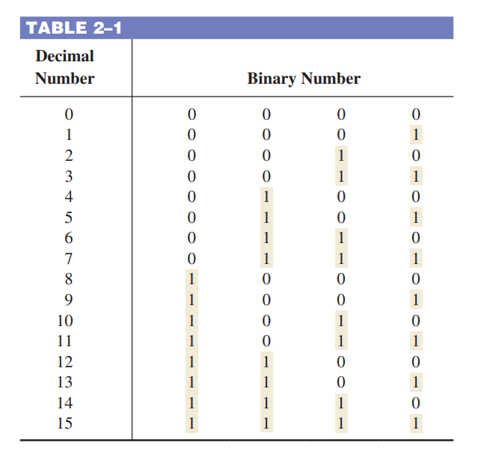
BINARY NUMBER

Slide 28
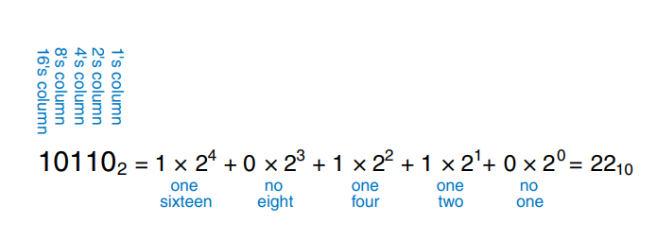
BINARY NUMBER
512 | 256 | 128 | 64 | 32 | 16 | 8 | 4 | 2 | 1
2⁹ | 2⁸ | 2⁷ | 2⁶ | 2⁵ | 2⁴ | 2³ | 2² | 2¹ | 2⁰

Slide 29
BINARY NUMBER

Slide 30
BINARY NUMBER

Slide 31
BINARY NUMBER

Slide 32
DECIMAL TO BINARY CONVERSION

Slide 33
DECIMAL TO BINARY CONVERSION

Slide 34
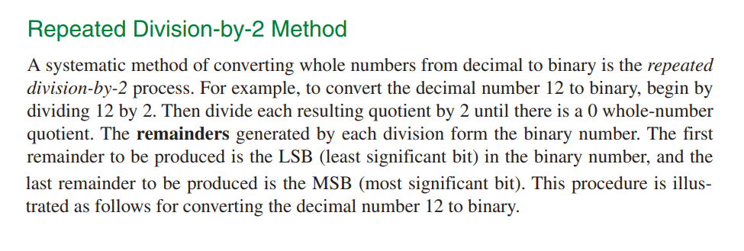
DECIMAL TO BINARY CONVERSION

Slide 35
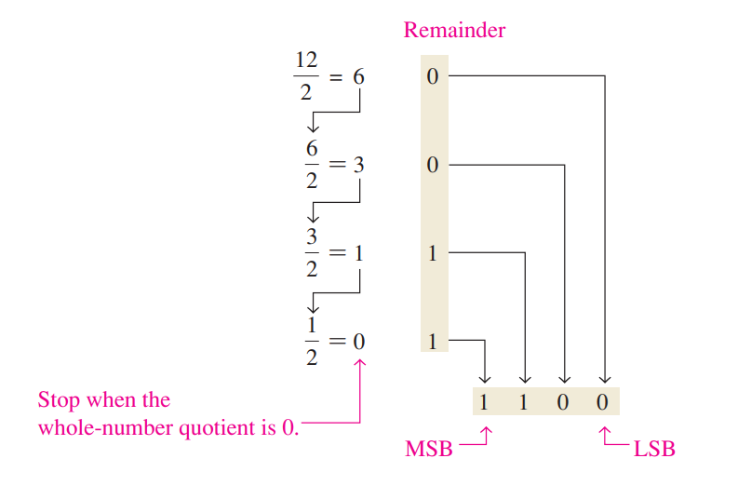
DECIMAL TO BINARY CONVERSION

Slide 36
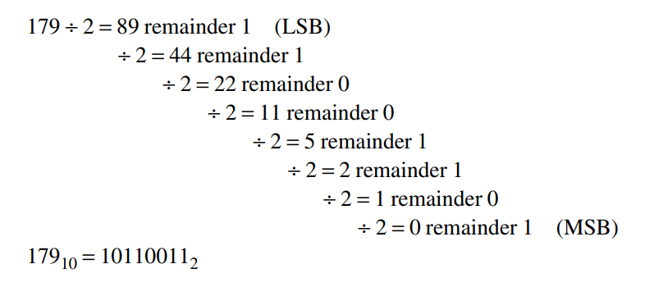
DECIMAL TO BINARY CONVERSION

Slide 37
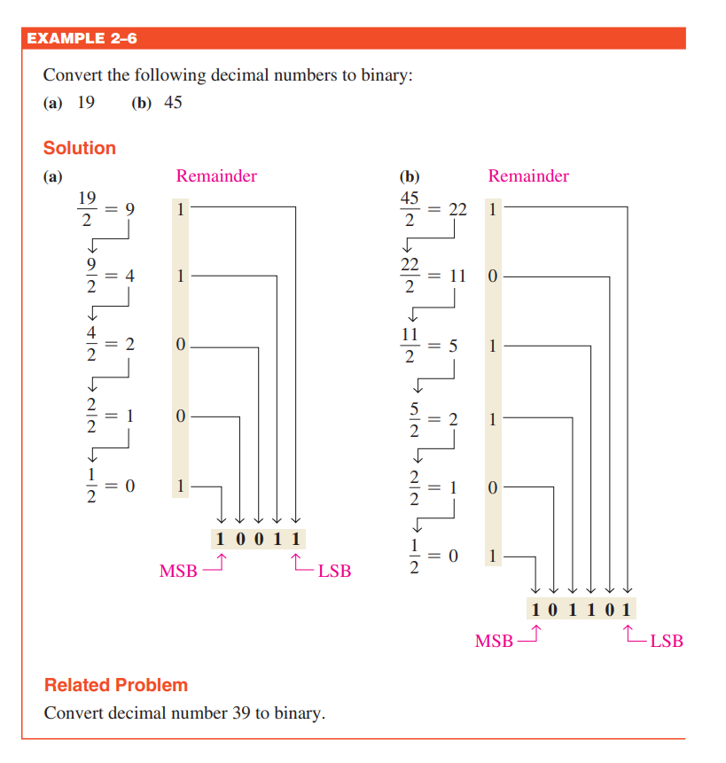
DECIMAL TO BINARY CONVERSION

Slide 38
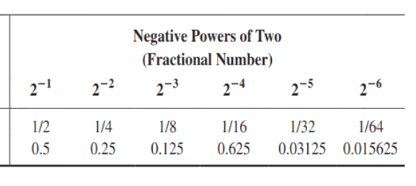
DECIMAL TO BINARY CONVERSION

Slide 39
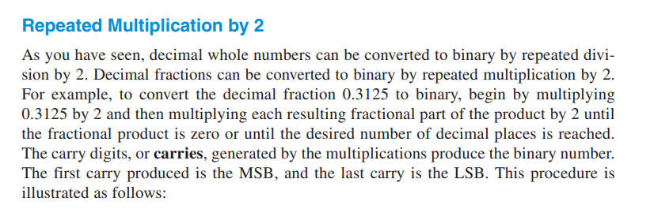
DECIMAL TO BINARY CONVERSION
Converting Decimal Fractions to Binary

Slide 40
DECIMAL TO BINARY CONVERSION
Converting Decimal Fractions to Binary

Slide 41
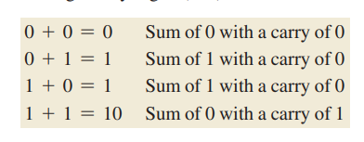
BINARY ARITHMATIC
Binary arithmetic is essential in all digital computers and in many other types of digital systems. To understand digital systems, you must know the basics of binary addition, subtraction, multiplication, and division.

Slide 42
BINARY ARITHMATIC

Slide 43
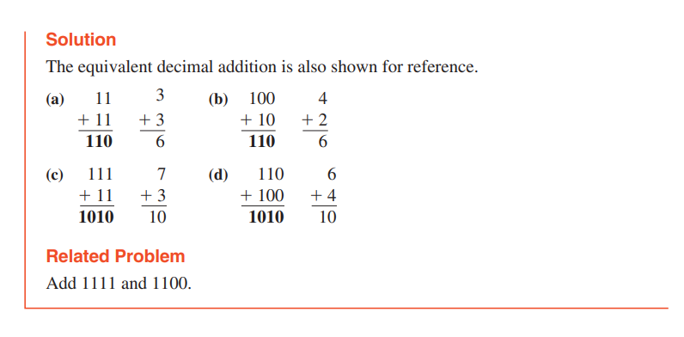
BINARY ARITHMATIC

Slide 44
BINARY ARITHMATIC

Slide 45
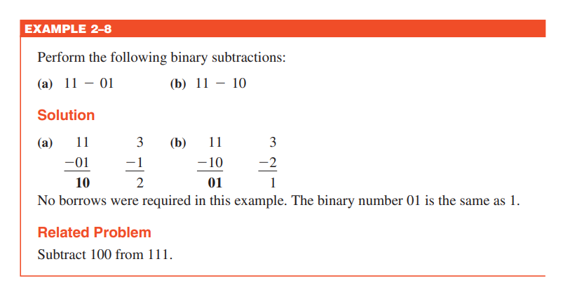
BINARY ARITHMATIC

Slide 46
BINARY ARITHMATIC

Slide 47
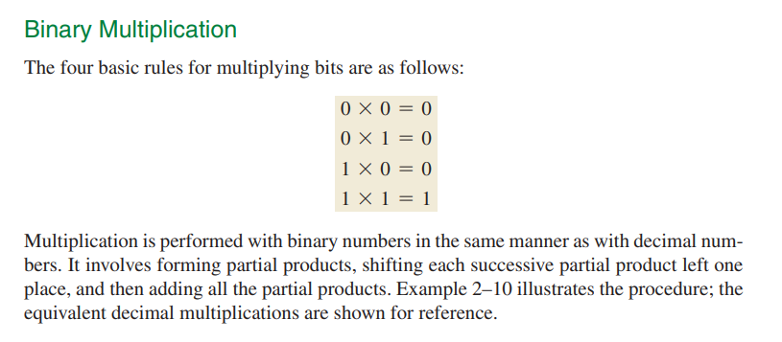
BINARY ARITHMATIC

Slide 48
BINARY ARITHMATIC

Slide 49
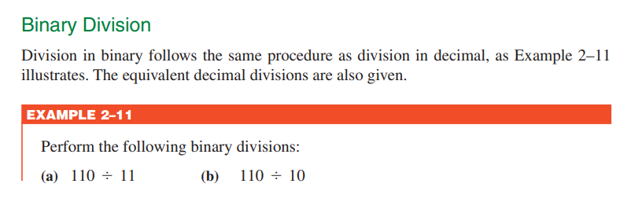
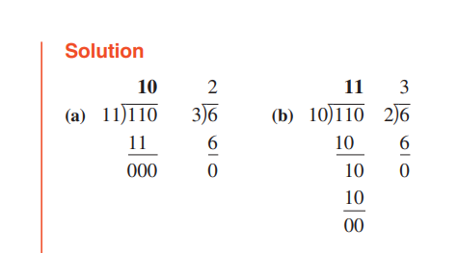
BINARY ARITHMATIC

Slide 50
BINARY ARITHMATIC

Slide 51
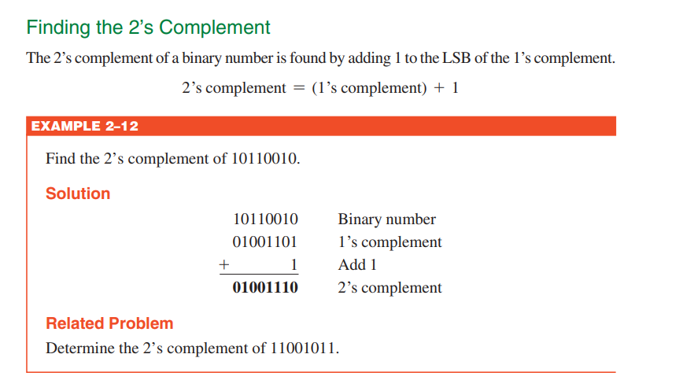
BINARY ARITHMATIC

Slide 52
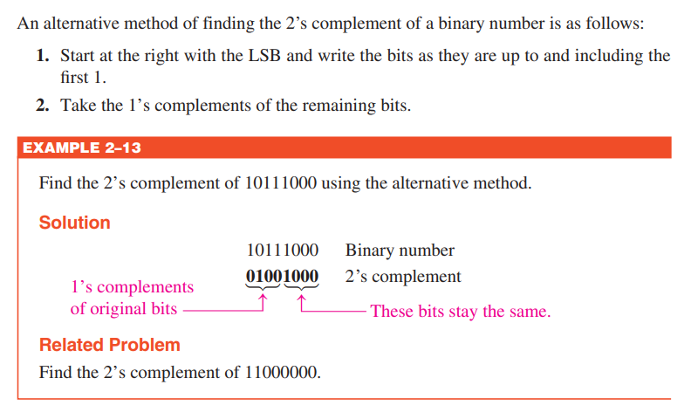
BINARY ARITHMATIC

Slide 53
REPRESENTATION OF NEGATIVE NUMBERS

Slide 54
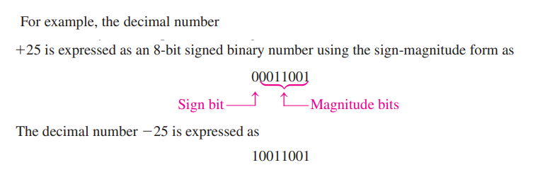
REPRESENTATION OF NEGATIVE NUMBERS

Slide 55
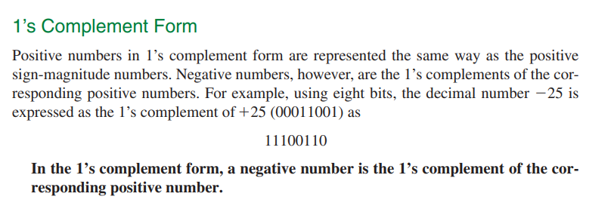
REPRESENTATION OF NEGATIVE NUMBERS

Slide 56
REPRESENTATION OF NEGATIVE NUMBERS

Slide 57
REPRESENTATION OF NEGATIVE NUMBERS

Slide 58
REPRESENTATION OF NEGATIVE NUMBERS

