Slide 1
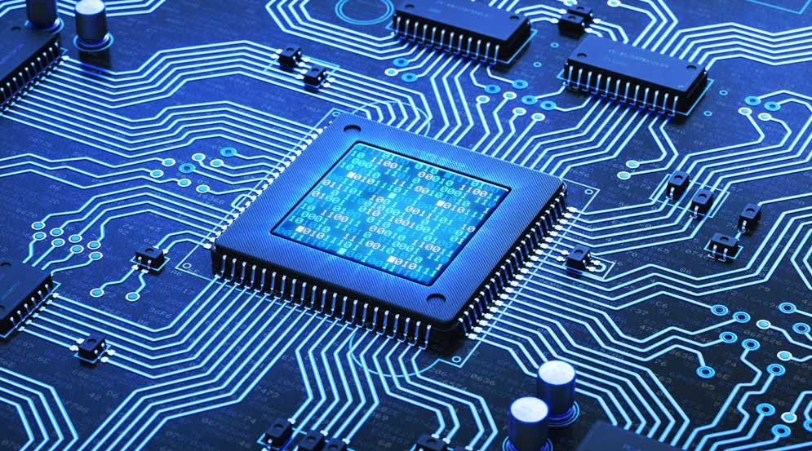
COMPUTER ARCITECTURE
DTI 112
AND OPERATING SYSTEM

Slide 2
DTI 112 COMPUSTER ARCHITECTURE
Link to powerpoint handout :
https://kbucomsci.weebly.com
QR-Code to handout :

Slide 3
IMPORTANCE OF STUDYING COMPUTER ARCHITECTURE
Computer architecture is the bedrock upon which modern computing is built. It encompasses the design, functionality, and operational processes of computer systems. Understanding computer architecture is crucial for several reasons, spanning from enhancing performance and efficiency to fostering innovation and ensuring security.

Slide 4
IMPORTANCE OF STUDYING COMPUTER ARCHITECTURE
Performance Optimization:
One of the primary reasons to study computer architecture is to optimize system performance. By understanding how different components of a computer system interact, such as the CPU, memory, and input/output devices, one can design more efficient systems. For instance, knowledge of pipelining and superscalar architectures allows engineers to increase the instruction throughput of CPUs. Techniques such as parallel processing and multi-core architectures are essential for maximizing performance, particularly in data-intensive and real-time applications.

Slide 5
IMPORTANCE OF STUDYING COMPUTER ARCHITECTURE
2. Efficiency and Cost-Effectiveness:
Studying computer architecture helps in designing cost-effective and energy-efficient systems. Efficient use of resources, such as minimizing power consumption and heat generation, is crucial, especially in large data centers and mobile devices where battery life is a constraint. Understanding the trade-offs between different design choices, such as RISC (Reduced Instruction Set Computer) versus CISC (Complex Instruction Set Computer) architectures, allows for informed decisions that balance performance with power and cost.

Slide 6
IMPORTANCE OF STUDYING COMPUTER ARCHITECTURE
3. Innovation and Technological Advancement:
A deep understanding of computer architecture is foundational for innovation in computing technology. It enables the development of new architectures that can handle emerging applications like artificial intelligence, machine learning, and big data analytics. For example, neuromorphic computing, which mimics the neural structures of the human brain, and quantum computing, which leverages the principles of quantum mechanics, are areas where breakthroughs in architecture could revolutionize the field.

Slide 7
IMPORTANCE OF STUDYING COMPUTER ARCHITECTURE
4. Software Development and Optimization:
Knowledge of computer architecture is vital for software developers. It helps them write optimized code that fully leverages the underlying hardware. Understanding how instructions are executed, memory is accessed, and data is transferred can lead to significant improvements in software performance. For example, awareness of cache hierarchies and memory access patterns can help developers design software that minimizes cache misses and improves execution speed.

Slide 8
IMPORTANCE OF STUDYING COMPUTER ARCHITECTURE
5. Educational and Professional Growth:
For students and professionals in computer science and engineering, knowledge of computer architecture is fundamental. It provides a comprehensive understanding of how computers work at a low level, which is essential for careers in hardware design, systems engineering, and various other fields. This foundational knowledge also supports lifelong learning and adaptation as technology evolves.

Slide 9
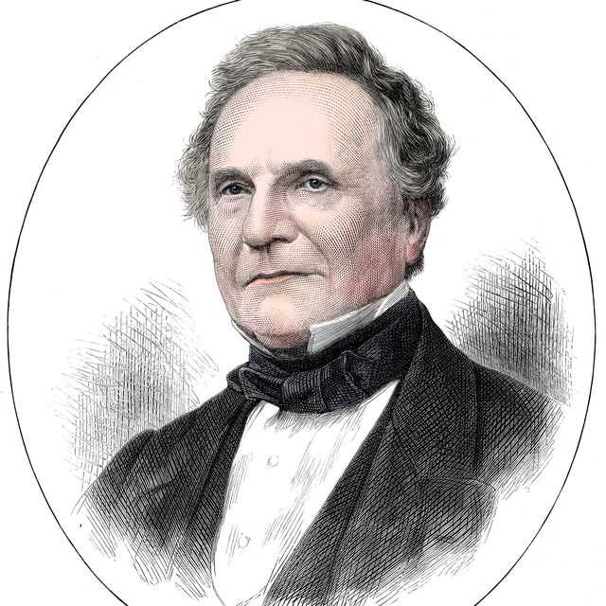
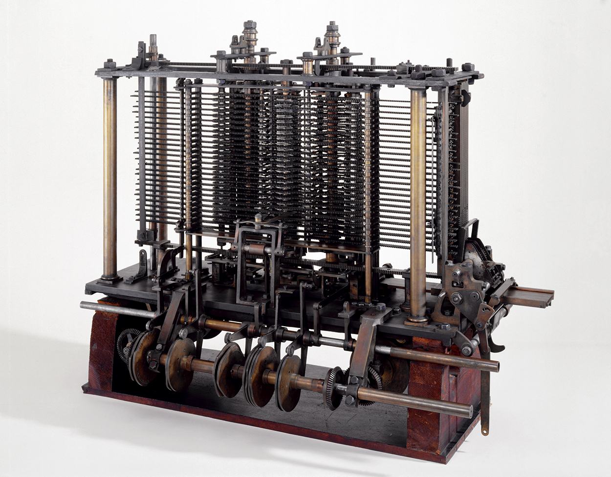
HISTORY AND EVOLUTION OF COMPUTER ARCHITECTURE
Early Mechanical Computers (1837)
Charles Babbage: Known as the 'father of the computer,' Babbage designed the first automatic mechanical computer, the Analytical Engine, which contained basic components such as an ALU, control flow in the form of conditional branching and loops, and integrated memory.

Slide 10
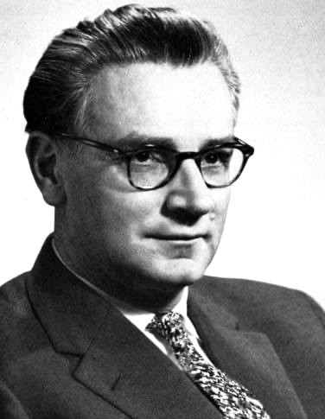
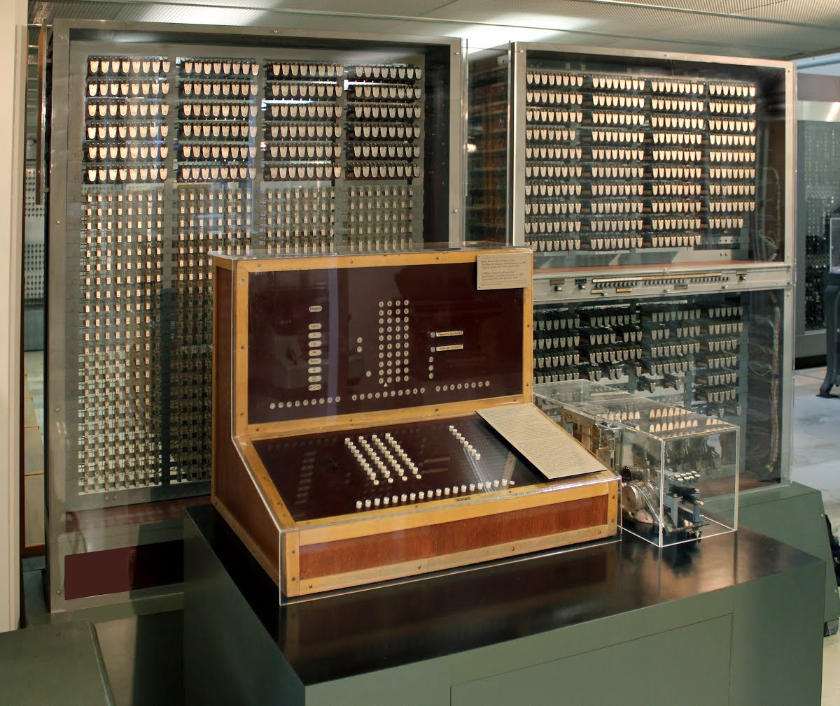
HISTORY AND EVOLUTION OF COMPUTER ARCHITECTURE
Electromechanical Relays and the Zuse Z3 (1941)
Konrad Zuse: Built the Z3, the world's first working programmable, fully automatic digital computer.

Slide 11
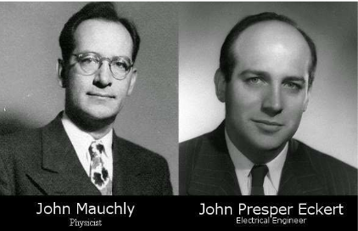
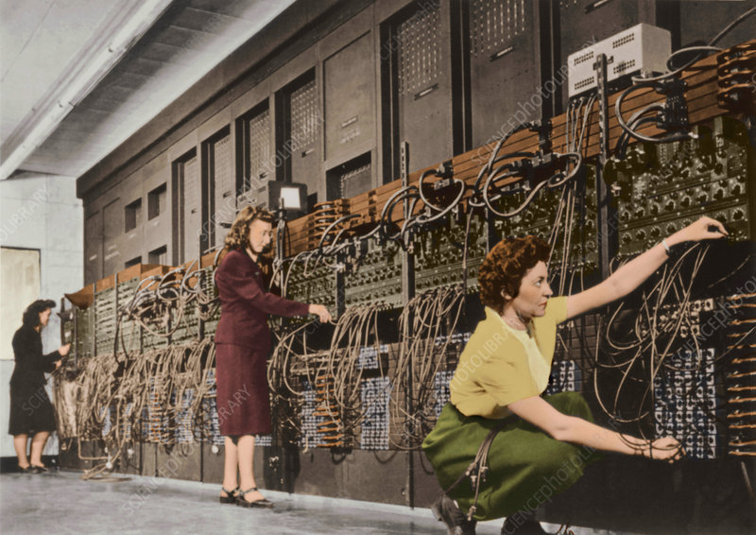
HISTORY AND EVOLUTION OF COMPUTER ARCHITECTURE
The ENIAC (1945)
John Presper Eckert and John Mauchly: Developed the Electronic Numerical Integrator and Computer (ENIAC), the first general-purpose electronic digital computer.
The ENIAC used decimal rather than binary and was the first to use the architecture that separates memory from the central processing unit.

Slide 12
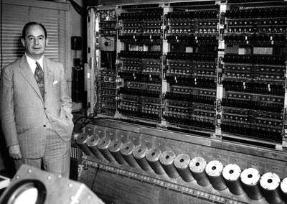
HISTORY AND EVOLUTION OF COMPUTER ARCHITECTURE
Von Neumann Architecture (1945)
John von Neumann: Proposed the stored-program concept, which became the foundation for most computer architectures.
Introduction of a single memory space for both instructions and data, leading to the Von Neumann bottleneck.

Slide 13
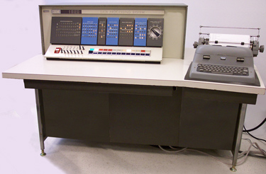
HISTORY AND EVOLUTION OF COMPUTER ARCHITECTURE
Transistor Computers (1950s)
Bell Labs: Developed the transistor, replacing vacuum tubes in computers, significantly reducing size, heat, and power consumption.
The transition from vacuum tubes to transistors marked the beginning of the second generation of computers.
IBM 1620 Model I, Level H
Manufacturer | IBM
Type | Scientific minicomputer
Release date | 1959
Units shipped | About 2000
CPU | Transistorized, built with SMS cards, variable 12-72 bit words @ 50 kHz (20 us)
Memory | 20,000-60,000 words (Core memory)

Slide 14
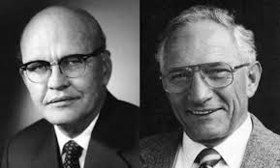
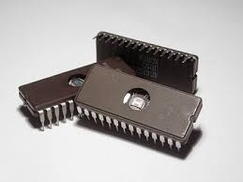
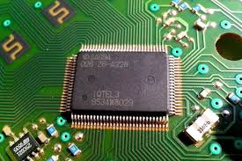
HISTORY AND EVOLUTION OF COMPUTER ARCHITECTURE
Integrated Circuits (1960s)
Jack Kilby and Robert Noyce: Independently invented the integrated circuit, which allowed for the miniaturization of computer components.
Integration of multiple transistors on a single chip, leading to the third generation of computers.
Jack Kilby Robert Noyce

Slide 15
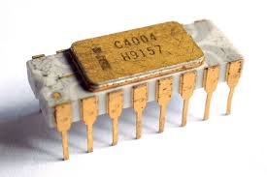
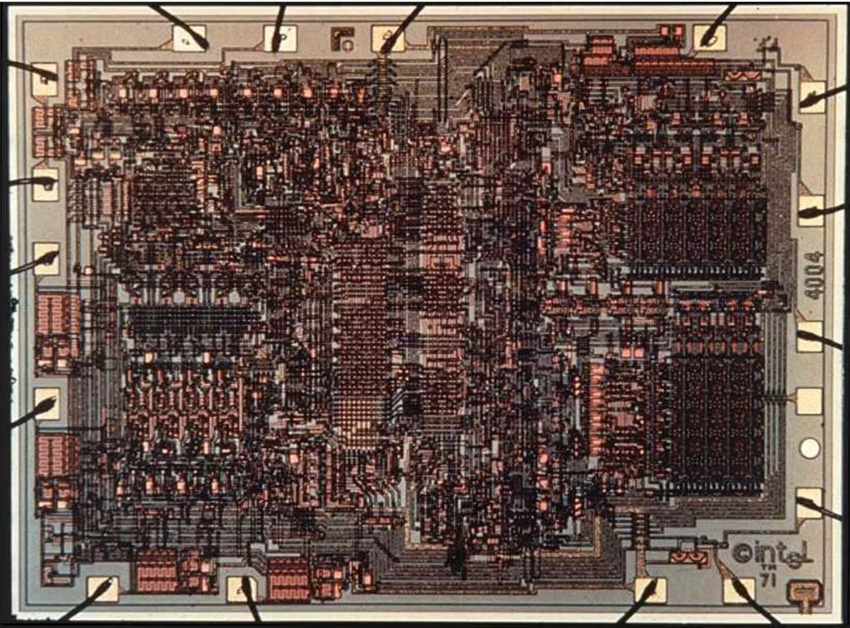
HISTORY AND EVOLUTION OF COMPUTER ARCHITECTURE
Microprocessors (1971)
Intel 4004: The first commercially available microprocessor, revolutionizing computer design by integrating the CPU onto a single chip.
The birth of personal computers and the fourth generation of computers.
Intel 4004

Slide 16
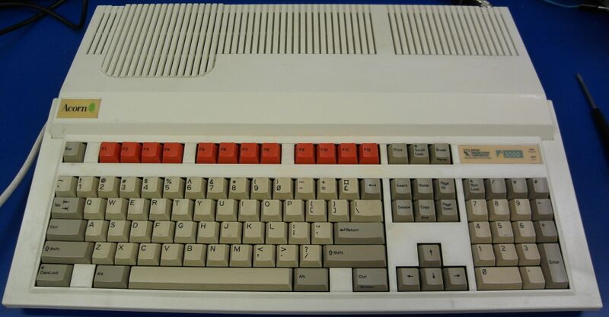
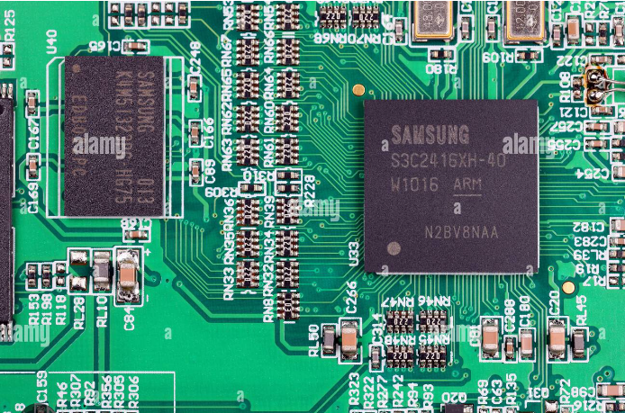
HISTORY AND EVOLUTION OF COMPUTER ARCHITECTURE
RISC (1980s)
David Patterson and John Hennessy: Developed the Reduced Instruction Set Computer (RISC) architecture, focusing on a simplified set of instructions for faster processing.
The RISC emphasizing efficiency and simplicity.
RISC Machine with ARM CPU
Advance RISC Machine

Slide 17
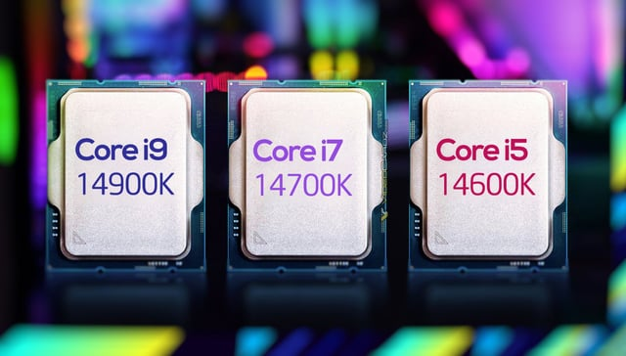
HISTORY AND EVOLUTION OF COMPUTER ARCHITECTURE
Parallel Processing and Multi-Core Processors (1990s-Present)
Advancements in Multi-Core Technology: CPUs began integrating multiple cores to handle parallel processing more effectively.
Improvement in processing power and efficiency, leading to the current trend of multi-core processors in consumer and enterprise systems.
Intel Multi-Core : Gen 14

Slide 18
DESIGN OF COMPUTER ARCHITECTURE DIFFERENT PLATFORMS, DIFFERENT GOALS
To achieve a set of design goals
E.g., highest performance on earth on workloads X, Y, Z
E.g., longest battery life at a form factor that fits in your pocket with cost < $$$ CHF
E.g., best average performance across all known workloads at the best performance/cost ratio
…
Designing a supercomputer is different from designing a smartphone → But, many fundamental principles are similar

Slide 19
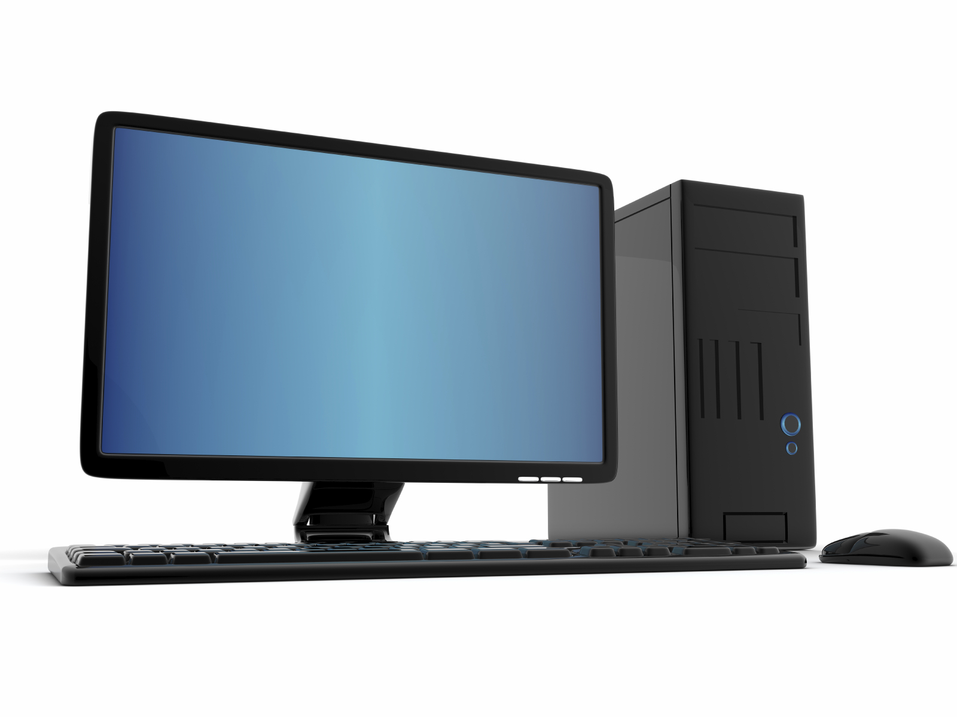
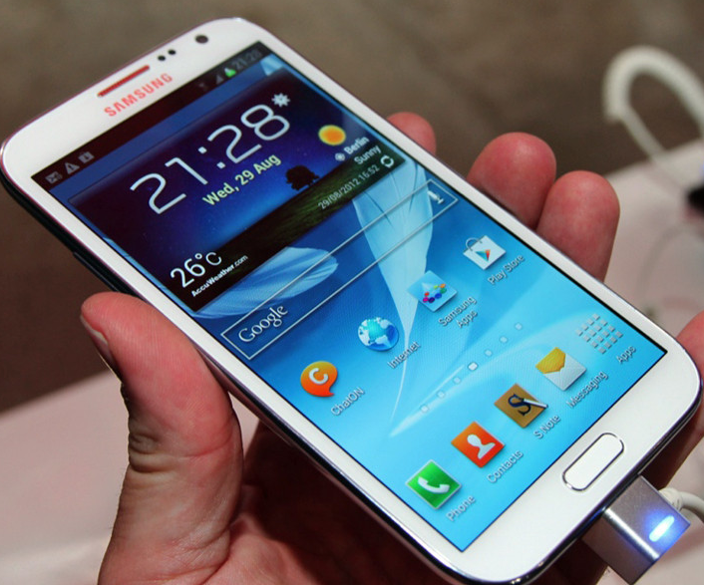
DIFFERENT PLATFORMS, DIFFERENT GOALS

Slide 20
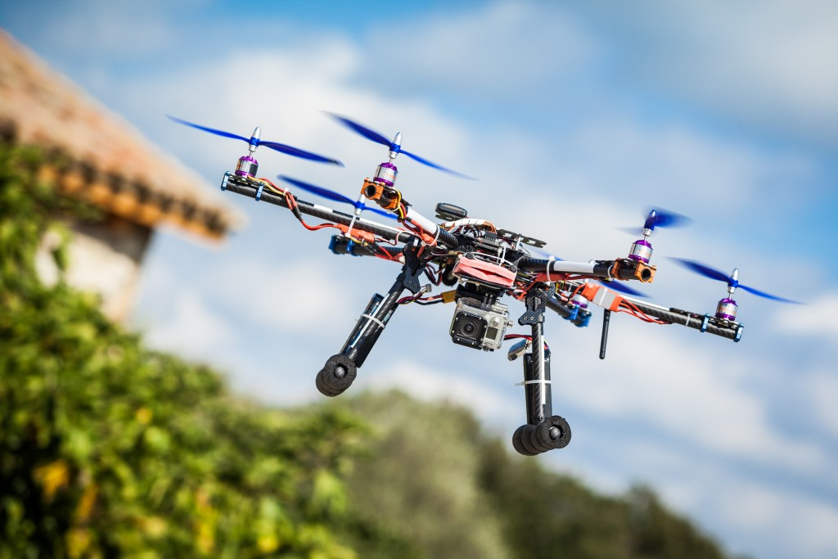
DIFFERENT PLATFORMS, DIFFERENT GOALS

Slide 21
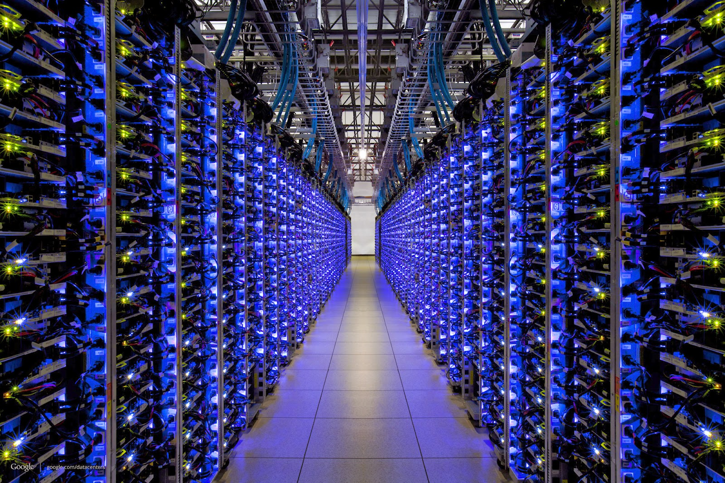
DIFFERENT PLATFORMS, DIFFERENT GOALS

Slide 22
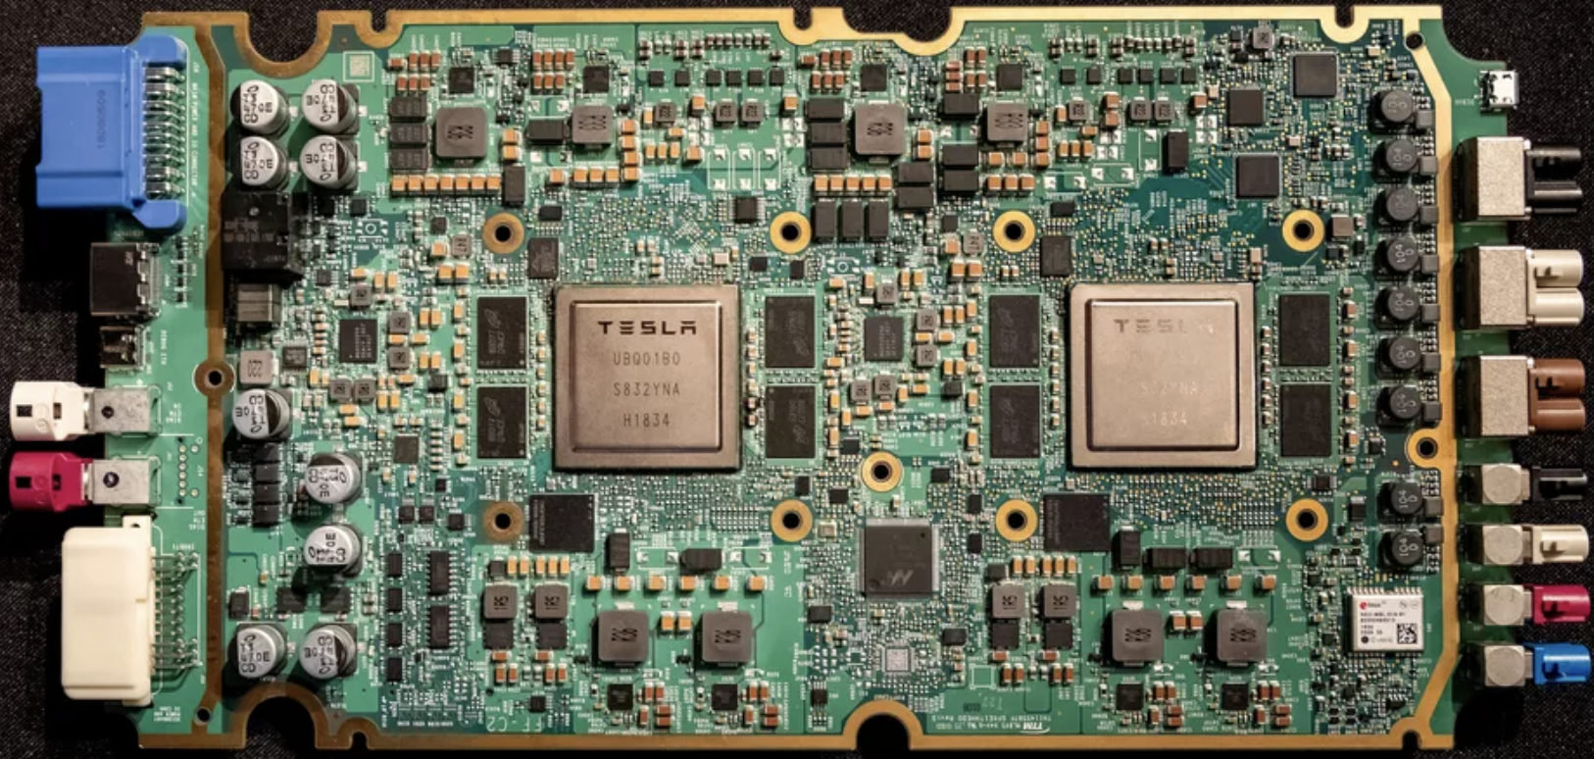
DIFFERENT PLATFORMS, DIFFERENT GOALS
ML accelerator: 260 mm², 6 billion transistors, 600 GFLOPS GPU, 12 ARM 2.2 GHz CPUs.

Slide 23
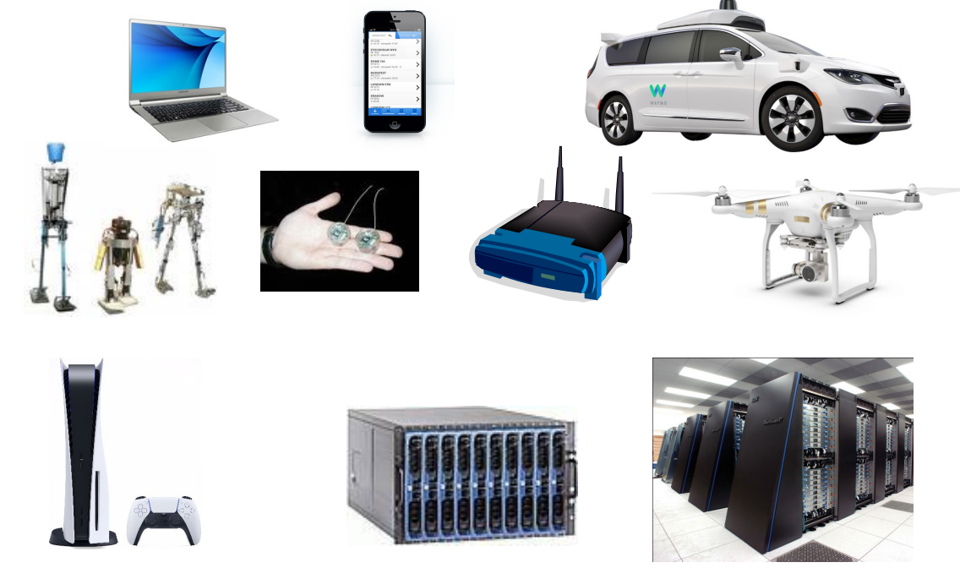
COMPUTING DEVICES NOW

Slide 24
CLASSES OF COMPUTERS
Internet of Things/Embedded Computers
Embedded computers are found in everyday machines: microwaves, washing machines, most printers, networking switches, and all automobiles.
Internet of Things (IoT) refers to embedded computers that are connected to the Internet, typically wirelessly.
Personal Mobile Device
Personal mobile device (PMD) is the term we apply to a collection of wireless devices with multimedia user interfaces such as cell phones, tablet computers, and so on.
Desktop Computing
Servers

Slide 25
TECHNOLOGY IS THE DOMINANT FACTOR IN COMPUTER DESIGN

Slide 26
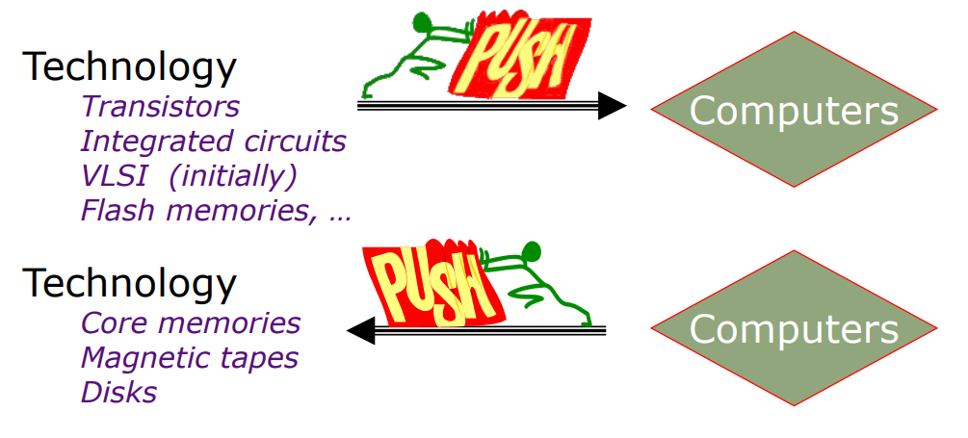
TECHNOLOGY IS THE DOMINANT FACTOR IN COMPUTER DESIGN

Slide 27
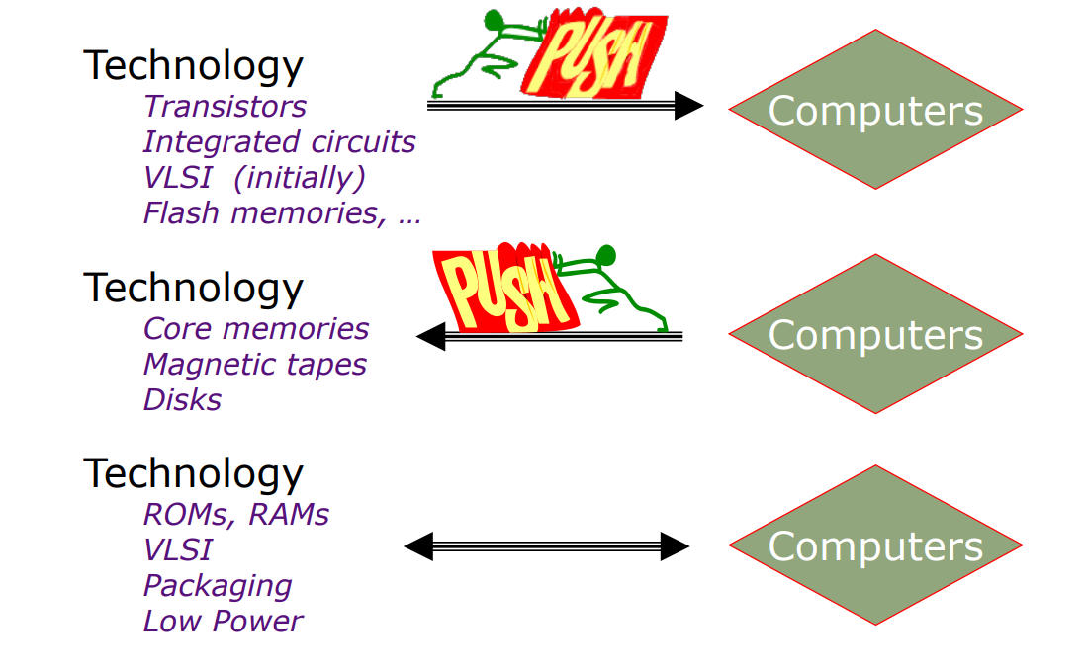
TECHNOLOGY IS THE DOMINANT FACTOR IN COMPUTER DESIGN

Slide 28
BUT SOFTWARE...

Slide 29
BUT SOFTWARE...

Slide 30
INTRODUCTION TO OPERATION SYSTEM
What is an OS?
"An operating system (OS) is a vital piece of software that acts as an intermediary between computer hardware and the user. It manages and coordinates all activities on the computer, ensuring that applications and hardware work together smoothly. Think of it as the manager that directs all operations on your device."

Slide 31
INTRODUCTION TO OPERATION SYSTEM
Functions of an OS
"The primary functions of an OS include managing hardware resources (CPU, memory, disk drives, and peripheral devices), providing a user interface, executing and providing services for application software, and ensuring secure and efficient operation of the system. Without an OS, users would not be able to interact with their computers in an effective manner."

Slide 32
INTRODUCTION TO OPERATION SYSTEM
Importance of OS in Computing:
Resource Management
"One of the critical roles of an OS is to manage the computer's resources. This includes the CPU, memory, disk space, and input/output devices. The OS allocates these resources to various applications and users, ensuring that each gets the necessary resources to function correctly without conflicts. For example, when you run multiple applications simultaneously, the OS schedules CPU time and allocates memory to each application, ensuring smooth operation."

Slide 33
INTRODUCTION TO OPERATION SYSTEM
Importance of OS in Computing:
User Interface
"Operating systems provide a user interface, which can be either graphical (GUI) or command-line (CLI). The GUI, such as those found in Windows and macOS, allows users to interact with the computer through graphical elements like windows, icons, and menus. The CLI, used in systems like Linux, allows interaction through text commands. The user interface is crucial because it defines how users interact with the computer and access its functions."

Slide 34
INTRODUCTION TO OPERATION SYSTEM
Importance of OS in Computing:
Application Support
"Operating systems provide a platform for running application software. They offer standard services and APIs (Application Programming Interfaces) that applications use to perform tasks, such as file operations and network communication. This support ensures that software developers can create applications that run on multiple hardware configurations without needing to customize their software for each hardware setup."

Slide 35
INTRODUCTION TO OPERATION SYSTEM
Importance of OS in Computing:
Security and Access Control
"Security is a paramount concern in computing, and the OS plays a central role in enforcing security measures. It manages user authentication, ensuring that only authorized users can access the system. It also controls access to system resources, preventing unauthorized access to files and devices. Additionally, the OS includes security features like firewalls and anti-virus tools to protect against external threats and malware."

Slide 36
INTRODUCTION TO OPERATION SYSTEM
Importance of OS in Computing:
System Performance and Efficiency
"Finally, the OS is responsible for maintaining system performance and efficiency. It optimizes the use of hardware resources and ensures that applications run efficiently. This involves managing processes, memory, and storage to avoid bottlenecks and ensure that the system runs smoothly. For instance, the OS employs various scheduling algorithms to manage process execution, balancing the load and maximizing CPU usage."

Slide 37
SUMMARY
In summary, the study of computer architecture is indispensable for optimizing performance, ensuring efficiency and cost-effectiveness, driving innovation, enhancing software development, and ensuring the security and reliability of computer systems. It is a cornerstone of education in computer science and engineering, providing the knowledge and skills necessary for tackling current and future technological challenges. As computing continues to evolve, the importance of a solid grounding in computer architecture will only increase, underscoring its critical role in the advancement of technology.

Slide 38
SUMMARY
Also the operating system is an essential component of any computing device. It not only enables users to interact with the hardware but also ensures the efficient and secure operation of the entire system. Understanding the OS's role and functions helps us appreciate how computers perform complex tasks seamlessly and reliably.

